Slide 1


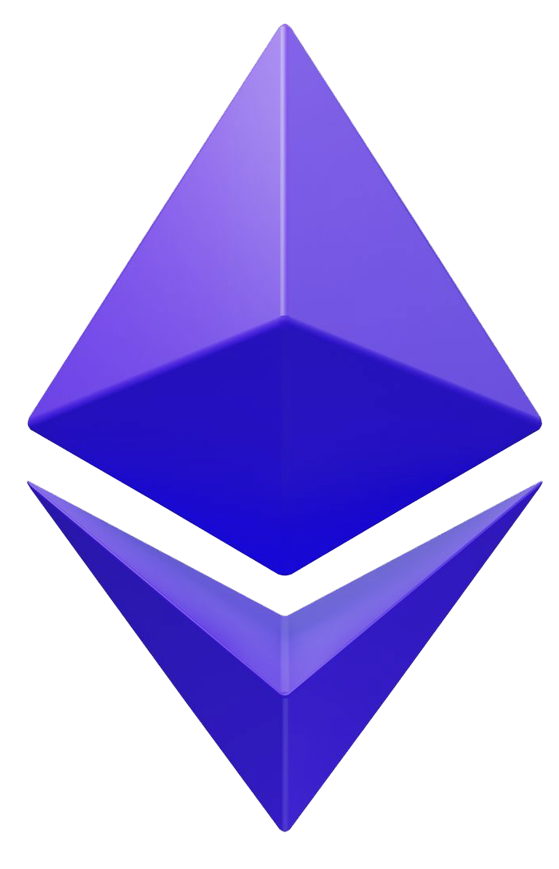
राष्ट्रीय इलेक्ट्रॉनिकी एवं सूचना प्रौद्योगिकी संस्थान, कोलकाता
National Institute of Electronics & Information Technology, Kolkata
EDUCATE
Portal
“A blockchain-based Decentralized Academic Verification
Solution for secure and verifiable academic credentials."
PROJECT DOCUMENTATION

Slide 2

EDUCATE Portal
Goal of the Project:
To develop a decentralized education portal that securely manages academic records and provides tamper-resistant, transparent, and real-time verification of certificates, student identity cards, and semester results using blockchain technology.
The system combines the MERN stack with Ethereum and Web3 technologies to anchor document hashes on-chain
3 Assets
MERN + Web3
Real-Time
Certificates, ID cards, semester results
Hybrid off-chain speed, on-chain trust
Instant QR and unique ID validation

Slide 3
EDUCATE Portal
Main Project Objectives
Digitize Management
Secure Issuance
Document Integrity
Centralized web portal for courses.
Blockchain-backed certificates and ID cards.
Cryptographic hashes stored on Ethereum.
Real-Time Verification
cryptographic Score cards
Automated Checks
Instant third-party QR code checks.
Dynamic result and certificate evaluation.
Eliminates manual background verification delays.

Slide 4


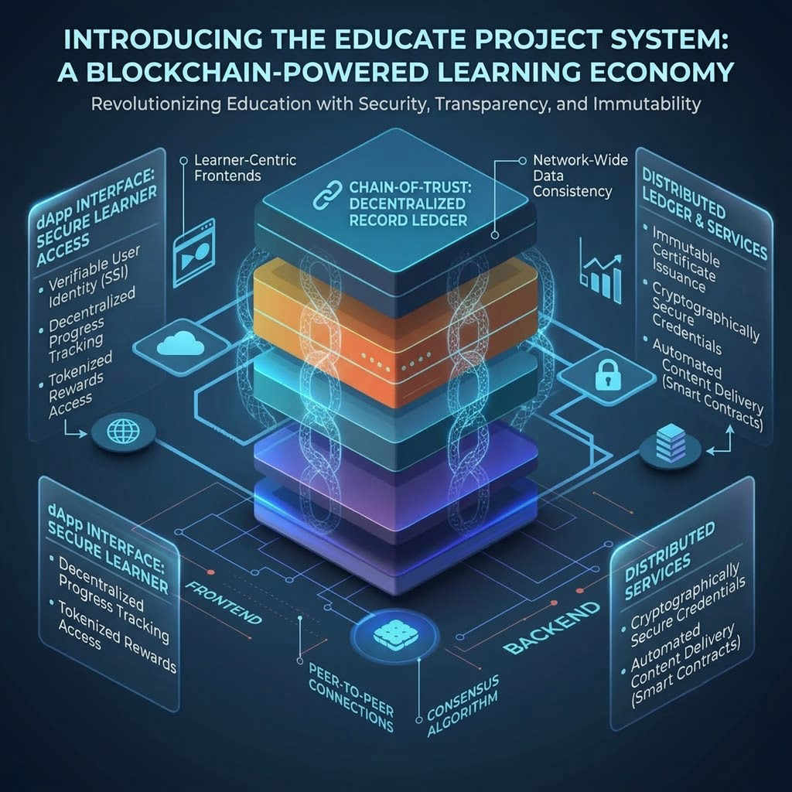
Document Forgery
Increasing prevalence of fake degrees and certificates undermines the value oflegitimate education.
Data Silos
Academic records are often stored in fragmented, centralized databases that are difficult to access across borders.
EDUCATE Portal
Introduction to EDUCATE Portal
Modernizing academic credential infrastructure through immutable blockchain records.
Paper Vulnerability: Physical certificates risk forgery and damage.
Verification Bottleneck: Conventional digital checks remain slow.
Decentralized Mandate: Eliminates single points of failure.
Hybrid Architecture: Pairs MERN web speed with Ethereum.
Ineefficient Verification
Manual background checks can take weeks, delaying employment and academic admissions.
High Admin Costs
Institutions spend significant resources responding to verification requests via traditional mail or email.

Slide 5

EDUCATE Portal
Problem Statement
Critical Friction Points
Systemic Failures
An analysis of the systemic failures in traditional academic record-keeping and the risks they pose to institutions andemployers.
Candidate Domain
Document Forgery
Ineefficient Verification
Manual background checks can take weeks, delaying employment and academic admissions.
— Allows students to view courses, examinations and results, request Web3 ID cards, and access verified certificates.
Increasing prevalence of fake degrees and certificates undermines the value oflegitimate education.
CORE INSIGHT
Data Silos
High Admin Costs
Decentralized Trust
Manual verification processes are slow, expensive, and vulnerable to sophisticated document forgery.
Academic records are often stored in fragmented, centralized databases that are difficult to access across borders.
Institutions spend significant resources responding to verification requests via traditional mail or email.
— Secures academic credentials, semester results, & student identity on an immutable ledger, preventing unauthorized modifications.
Admin Domain
— Manages courses, batches, student enrollment, examinations, results, ID-card requests, approvals, and certificate issuance.
Blockchain Domain
— acts as an immutable ledger where hashes and transaction information associated with academic credentials are recorded.

Slide 6
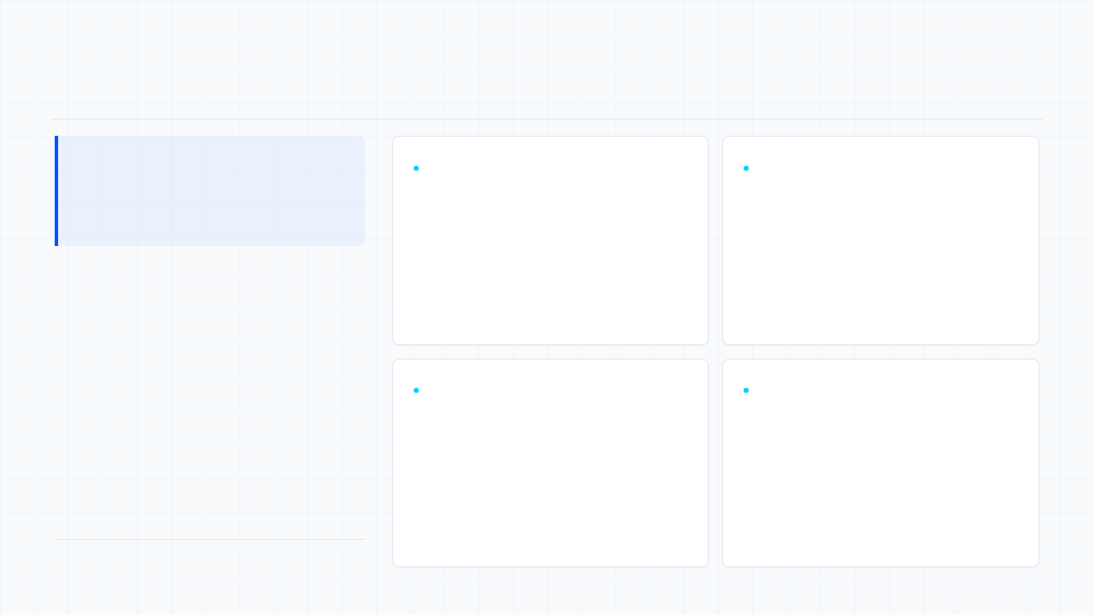
EDUCATE Portal
Project Proposal & Solution
The proposed solution consists of three primary domains:
Proposal
The EDUCATE Portal is proposed as a web-based education management and credential verification platform that combines the MERN stack with Ethereum blockchain technology. The system is designed to manage courses, student enrollment, examinations, semester results, student identity cards, and academic certificates.
Admin Domain
Candidate Domain
Ineefficient Verification
— Manages courses, batches, student enrollment, examinations, results, ID-card requests, approvals, and certificate issuance.
— Allows students to view courses, examinations and results, request Web3 ID cards, and access verified certificates.
Manual background checks can take weeks, delaying employment and academic admissions.
Blockchain Domain
Decentralized Trust
High Admin Costs
— acts as an immutable ledger where hashes and transaction information associated with academic credentials are recorded.
— Secures academic credentials, semester results, & student identity on an immutable ledger, preventing unauthorized modifications.
Institutions spend significant resources responding to verification requests via traditional mail or email.
Document Forgery
Increasing prevalence of fake degrees and certificates undermines the value oflegitimate education.
Data Silos
Academic records are often stored in fragmented, centralized databases that are difficult to access across borders.

Slide 7
EDUCATE Portal
Project Scope Building a Secure Ecosystem
Comprehensive management tools for creating courses, managing batches, enrolling students, scheduling exams, processing results, issuing certificates, and approving/minting digital ID cards.
Admin Dashboard:
A comprehensive ecosystem for
document issuance, storage, and
instant third-party verification.
Automated Issuance
Decentralized Storage
Tools for educational institutions to issue
tamper-proof digital certificates directly to the
blockchain.
Leveraging IPFS for secure, distributed storage
of document metadata and assets.
Candidate Dashboard
A personalized portal for students to view enrolled courses, track upcoming exams, check semester results, request blockchain backed ID cards, and access their verified certificates
Detailed management of marks and subjects dynamically based on the course type:
Dynamic Result &
Grade Management
Certificate Courses: Direct evaluation with 2 core subjects.
Diploma/Graduation Courses: Semester-based evaluation featuring 5 subjects per semester. The final consolidated certificate is only generated after all semesters are successfully completed.
CORE INSIGHT
Instant Verification
Student Ownership
Maintain sensitive personal information in the application database while exposing only appropriate public identifiers and cryptographic information on the blockchain
A public-facing portal for employers and
institutions to verify credentials in seconds
using cryptographic proofs.
Empowering learners to own and share their
academic records without relying on
intermediaries.
Blockchain-based
Document Verification
Generates a cryptographic hash of certificate, ID card, and individual semester result details, securely storing them on the Ethereum blockchain. This ensures absolute immutability and verifiable authenticity.
Decentralized Trust
Secures academic credentials, semester results, and student identity on an immutable ledger, preventing unauthorized modifications.
ARCHITECTURE SPECIFICATION // V1.0
ARCHITECTURE SPECIFICATION // V1.0

Slide 8



EDUCATE Portal
Project features
Comprehensive management tools for creating courses, managing batches, enrolling students, scheduling exams, processing results, issuing certificates, and approving/minting digital ID cards.
Admin Dashboard:
Candidate Dashboard
A personalized portal for students to view enrolled courses, track upcoming exams, check semester results, request blockchain backed ID cards, and access their verified certificates
Detailed management of marks and subjects dynamically based on the course type:
Dynamic Result &
Grade Management
Certificate Courses: Direct evaluation with 2 core subjects.
Diploma/Graduation Courses: Semester-based evaluation featuring 5 subjects per semester. The final consolidated certificate is only generated after all semesters are successfully completed.
Blockchain-based
Document Verification
Generates a cryptographic hash of certificate, ID card, and individual semester result details, securely storing them on the Ethereum blockchain. This ensures absolute immutability and verifiable authenticity.
Security Trust
Secures academic credentials, semester results, and student identity on an immutable ledger, preventing unauthorized modifications.
ARCHITECTURE SPECIFICATION // V1.0
Technical Feasibility
Operational Feasibility
Economic Feasibility
The project is technically feasible because the MERN stack provides an established architecture for scalable web applications, while Ethereum and Hardhat provide an established environment for smart-contract development and local blockchain testing.
The interface is designed to abstract blockchain complexity from administrators and students. Users interact with familiar web interfaces while blockchain transactions are handled by the application workflow.
During development, a local Hardhat network can be used to avoid gas costs. For production, optimized smart contracts and appropriate network selection can be used to control transaction costs.

Slide 9



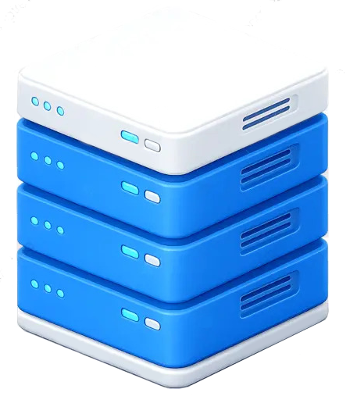
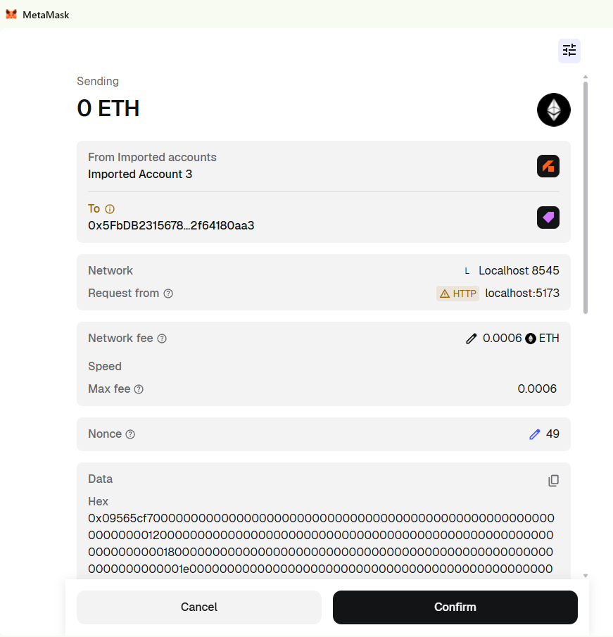
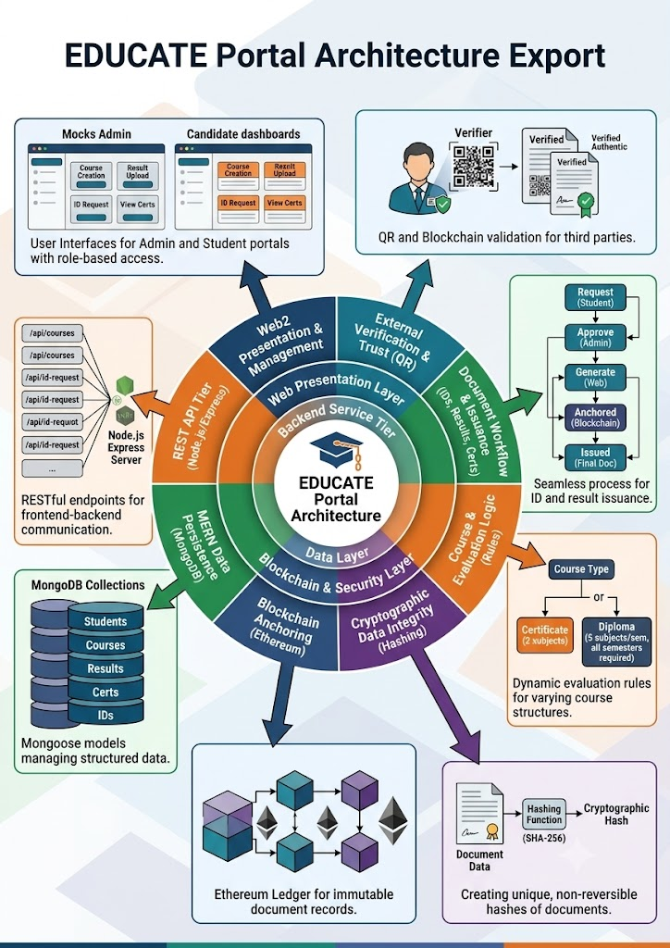
Architecture Used: Powering the Decentralized Web
EDUCATE Portal
Bridging operational speed with permanent cryptographic trust.
Project System
Analysis Design
LAYER 05 // IDENTITY
Integration with MetaMask for secure wallet-based authentication.
A modern Hybrid Web2 & Web3 Architecture Ensuring scalability, security, and a seamless user experience.
Administrative Domain
Identity Management
01
Manages the core educational workflows —from course creation to ID card approvals, semester result uploads, and final certificate issuance.
LAYER 04 // INTERFACE
React.js Vite and Bootstrap css for a responsive and Dynamic
intuitive user interface.
Frontend Framework
The system operates around three primary domains: Administration, Student Portal, and the Blockchain Network
Candidate Domain
02
LAYER 03 // SERVICES
Node.js and Express for API management and blockchain
Interaction via Web3.js/Ethers.js providing RESTful APIs.
Allows students to access their educational records, request Web3 ID cards, view individual semester results, and access cryptographic certificates upon course completion
Backend Services
MongoDB with Mongoose ODM for structured data storage
for hosting document files securely (Courses, Students,
Exams, Results, ID etc. )
LAYER 02 // STORAGE
Blockchain Domain
Decentralized Database Storage
03
Acts as the immutable ledger. When an ID card, semester result, or final certificate is generated, its unique hash and transaction details are permanently recorded on the blockchain.
Ethereum Network, Solidity Smart Contracts, Hardhat (local Ethereum node), and Ethers.js/Web3.js for seamless backend-to-blockchain communication.
CORE LEDGER
LAYER 01 // TRUST
Blockchain Layer

Slide 10

Administrative Domain
Manages the core educational workflows —from course creation to ID card approvals, semester result uploads, and final certificate issuance.
01
Candidate Domain
Allows students to access their educational records, request Web3 ID cards, view individual semester results, and access cryptographic certificates upon course completion
02
Blockchain Domain
Acts as the immutable ledger. When an ID card, semester result, or final certificate is generated, its unique hash and transaction details are permanently recorded on the blockchain.
03
SYS_REF_001
EDUCATE Portal
Architecture Used: Powering the Decentralized Web
Development Methodology:
Project System
Analysis Design
Bridging operational speed with permanent cryptographic trust.
Utilizes an Iterative Agile-Waterfall Hybrid approach to ensure smart contract immutability and
rapid web interface iteration.
A modern Hybrid Web2 & Web3 Architecture Ensuring scalability, security, and a seamless user experience.
Requirements Gathering & System Analysis
Identified physical certificate forgery vulnerabilities and verification bottlenecks.
Mapped dynamic evaluation models (2 core subjects for Certificate courses vs. 5 subjects per semester for Diploma/Degree courses).
LAYER 05 // IDENTITY
Identity Management
Integration with MetaMask wallet for secure cryptographic transaction signing.
System Architecture & Data Modelling
Modeled 3NF database schema across 8 core entities (ERD).
Structured Level 0 Context, Level 1 Main Processes, and Level 2 Document Anchoring Data Flow
Diagrams (DFDs).
The system operates around three primary domains: Administration, Student Portal, and the Blockchain Network
LAYER 04 // INTERFACE
Frontend Framework
React.js Vite and Bootstrap css for a Dynamic responsive user interface.
Full-Stack Implementation & Smart Contracts
Backend Services
Node.js and Express REST API management Interaction via Web3.js/Ethers.js
Developed Node.js/Express REST APIs and React.js frontend dashboards.
Codified Solidity smart contracts (Certificate. Sol) and compiled bytecode using Hardhat.
Integrated ethers.js for browser and server Web3 communication.
LAYER 03 // SERVICES
LAYER 02 // STORAGE
Persistence Layer
MongoDB with Mongoose ODM for storing structured off-chain collections
Multi-Tier Testing & Security Auditing
CORE LEDGER
Integration testing for MongoDB and Ethereum synchronization.
Ethereum Network, Solidity Smart Contracts, Hardhat (local Ethereum node), and Ethers.js/Web3.js for seamless backend-to-blockchain communication.
Hybrid Infrastructure Deployment
Frontend: Static asset deployment on Vercel /Netlify.
Backend & DB: Node.js APIs on AWS/Render connected to a MongoDB Atlas cluster.
Blockchain: Solidity contracts deployed to Sepolia Testnet / Ethereum Mainnet.
LAYER 01 // TRUST
Blockchain Layer
LAYERED_ARCHITECTURE_SPEC

Slide 11
EDUCATE Portal
Project Flow Process : Module
A seamless transition from traditional record-keeping to blockchain-verified credentials.
01
03
Course & Batch Setup
02
Web3 ID Issuance
04
Admin creates Certificate or Diploma course and initializes Batch.
Candidate Onboarding
Candidate requests ID; Admin approves and mints on Ethereum.
Exam Scheduling
Students register on portal; Admin approves active batch assignment.
Admin schedules examination slots for specific batch and semester.

Slide 12
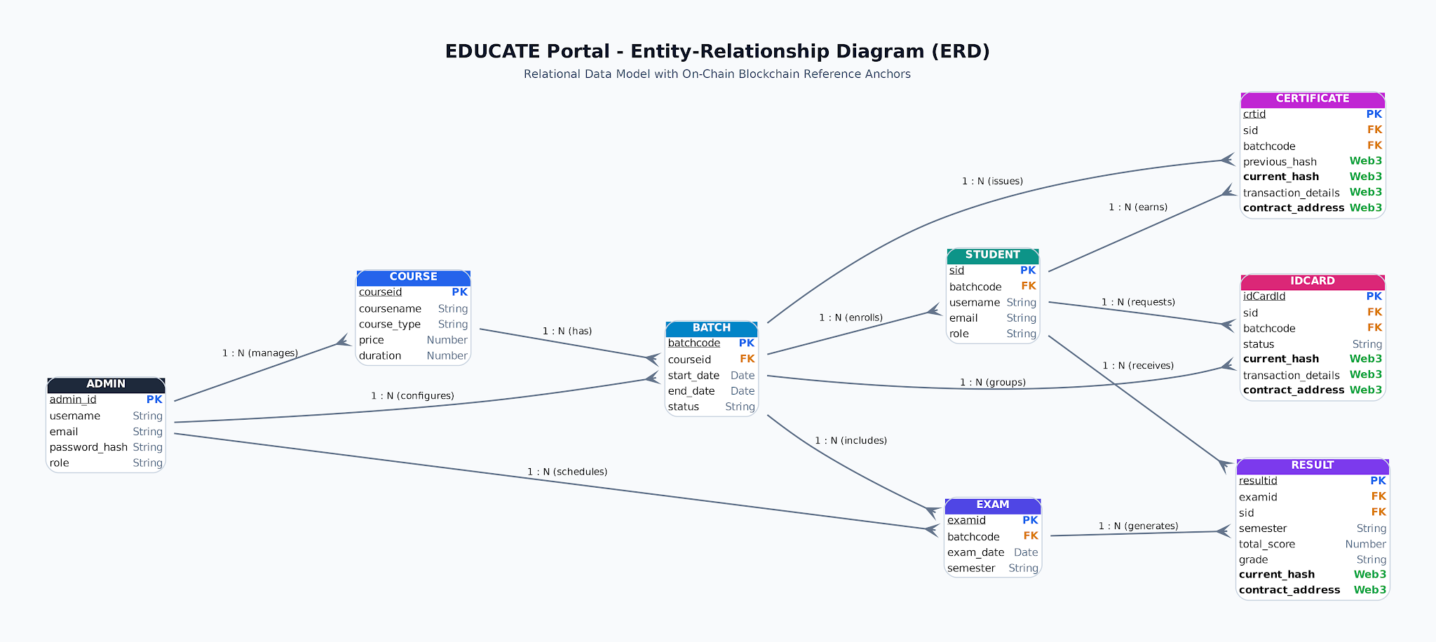
Data Entity Relationships
Detailed breakdown of the core data entities defining the system's
ledger integrity.
User Entity
Stores basic profile information and wallet addresses for
authentication.
Institution Entity
Contains verified details of authorized issuing bodies.
Certificate Entity
The central entity linking a student, an institution, and the specific
document hash.
Verification Log
Tracks verification attempts to provide audit trails for institutions.
EDUCATE Portal
Project Flow & Logic: The User Journey
CORE MANDATE
"Structured data relationships ensuring integrity
between users, institutions, and credentials."
A seamless transition from traditional record-keeping to blockchain-verified credentials.
01
03
05
02
04
Registration
Notification
Verification
Institutions undergo a one-
time verification to be
whitelisted on the platform.
Issuance
Students receive a
notification that their digital
credential is ready in their
wallet.
Sharing
The employer clicks the
link, the portal queries the
blockchain, and 'Verified'
status is displayed.
The institution uploads
student records; the
system generates hashes
and mints tokens.
The student provides a
public key or link to a
potential employer for
verification.

Slide 13
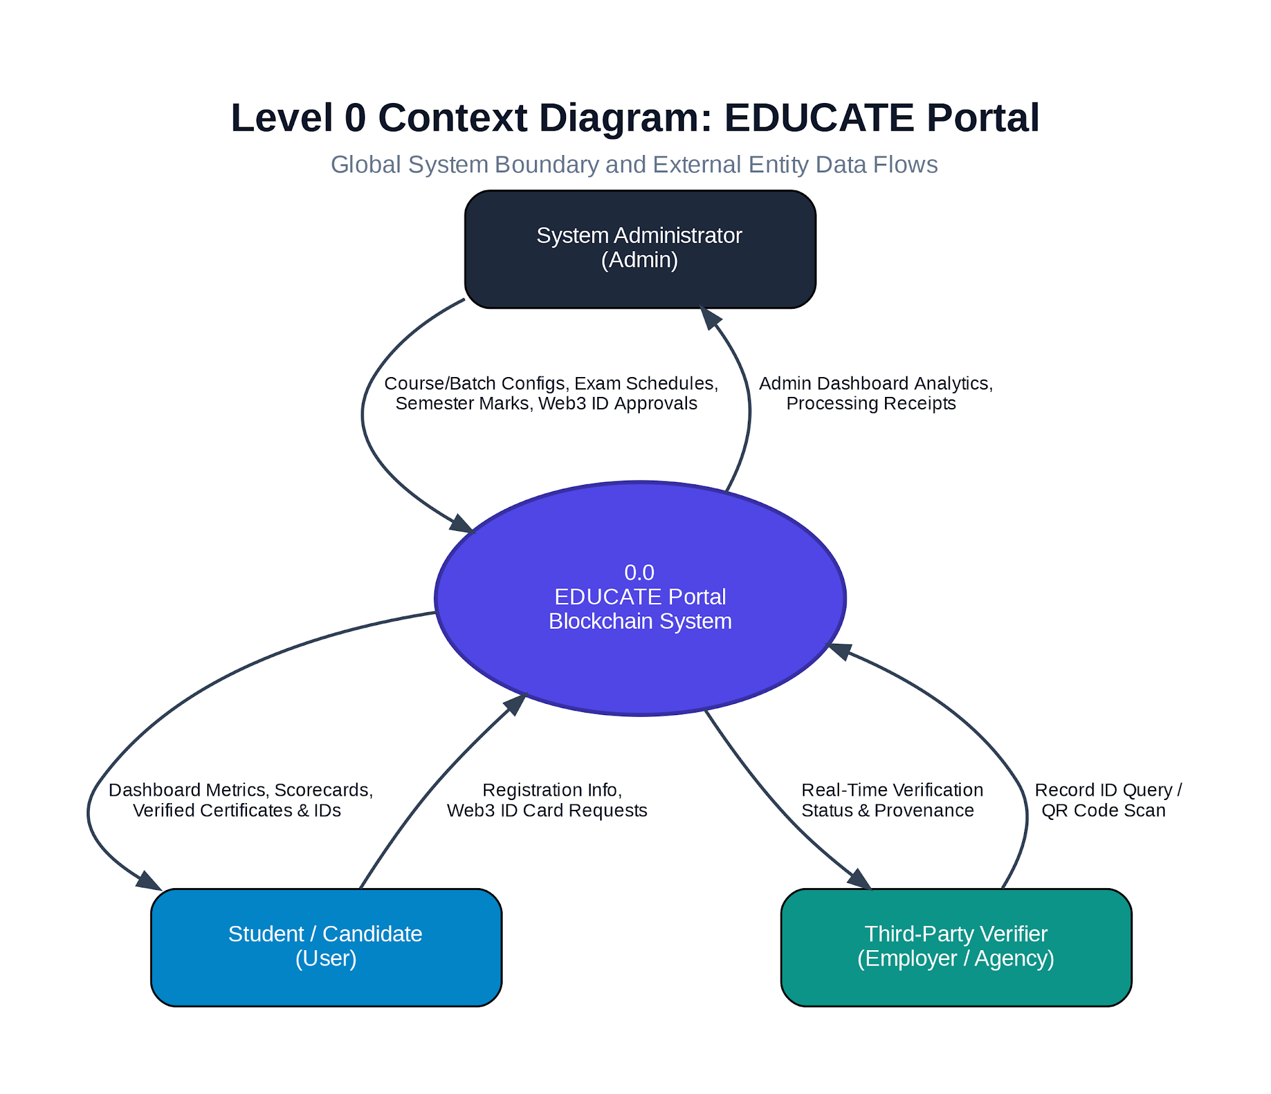
Sharing
Issuance
The student provides a
public key or link to a
potential employer for
verification.
The institution uploads
student records; the
system generates hashes
and mints tokens.
03
EDUCATE Portal
Entity Relationship Diagram (ERD)
"Structured data relationships ensuring integrity between users, institutions, and credentials."
Defines the global system boundary and data exchanges between
external actors and the central portal.
01
05
Admin
Course/batch configuration, exam scheduling, score uploads and
Web3 mint approvals.
Registration
Verification
Student / Candidate:
Institutions undergo a one-
time verification to be
whitelisted on the platform.
The employer clicks the
link, the portal queries the
blockchain, and 'Verified'
status is displayed.
Identity registration, dashboard queries, and digital ID card requests.
Third-Party Verifier:
Real-time record authentication using unique IDs or QR codes.
04
02
Notification
Students receive a
notification that their digital
credential is ready in their
wallet.

Slide 14
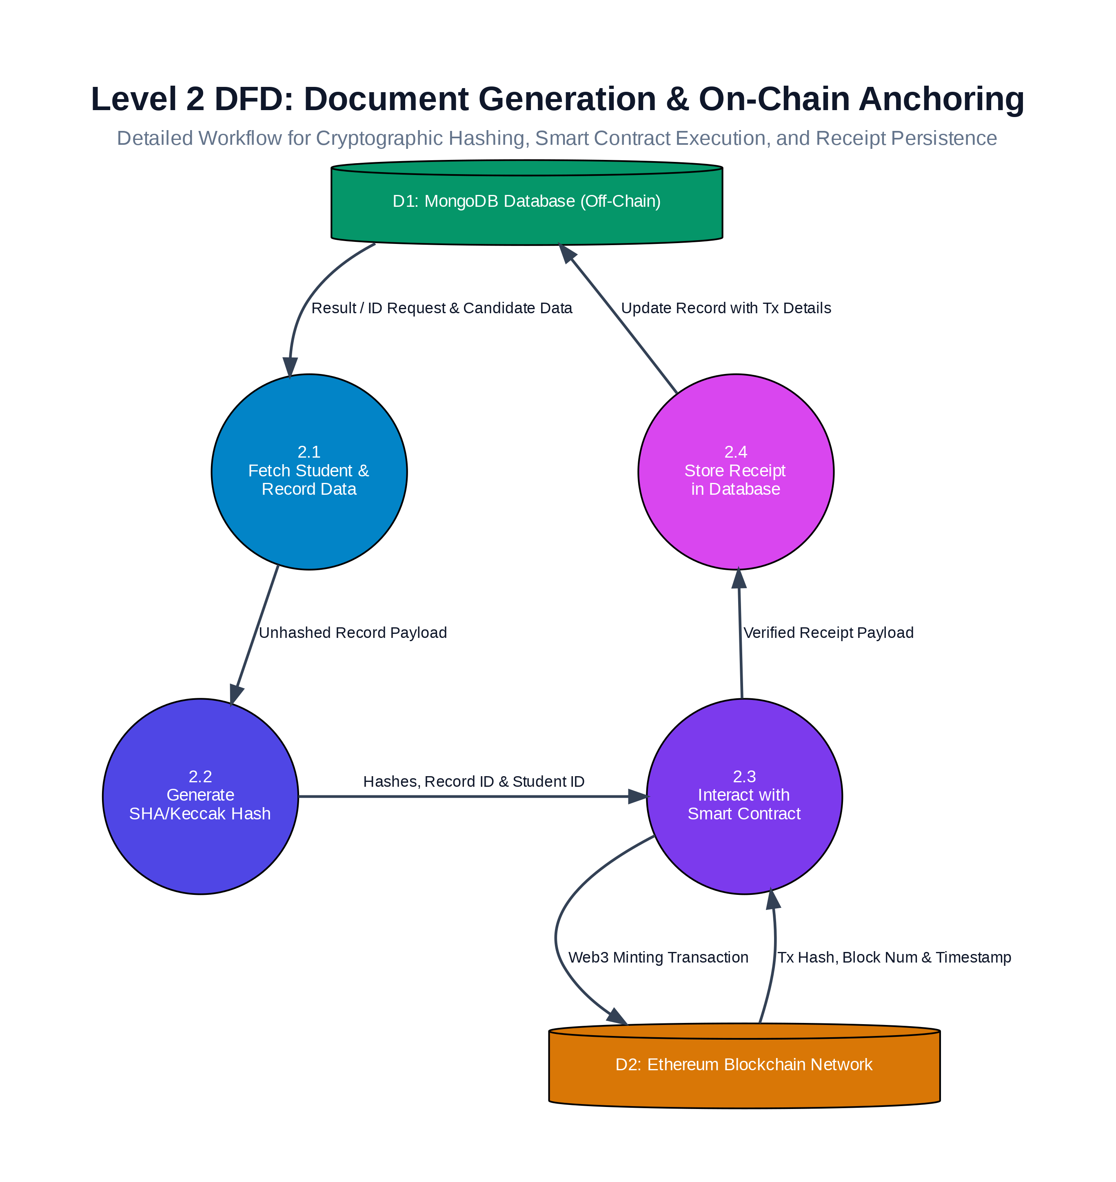
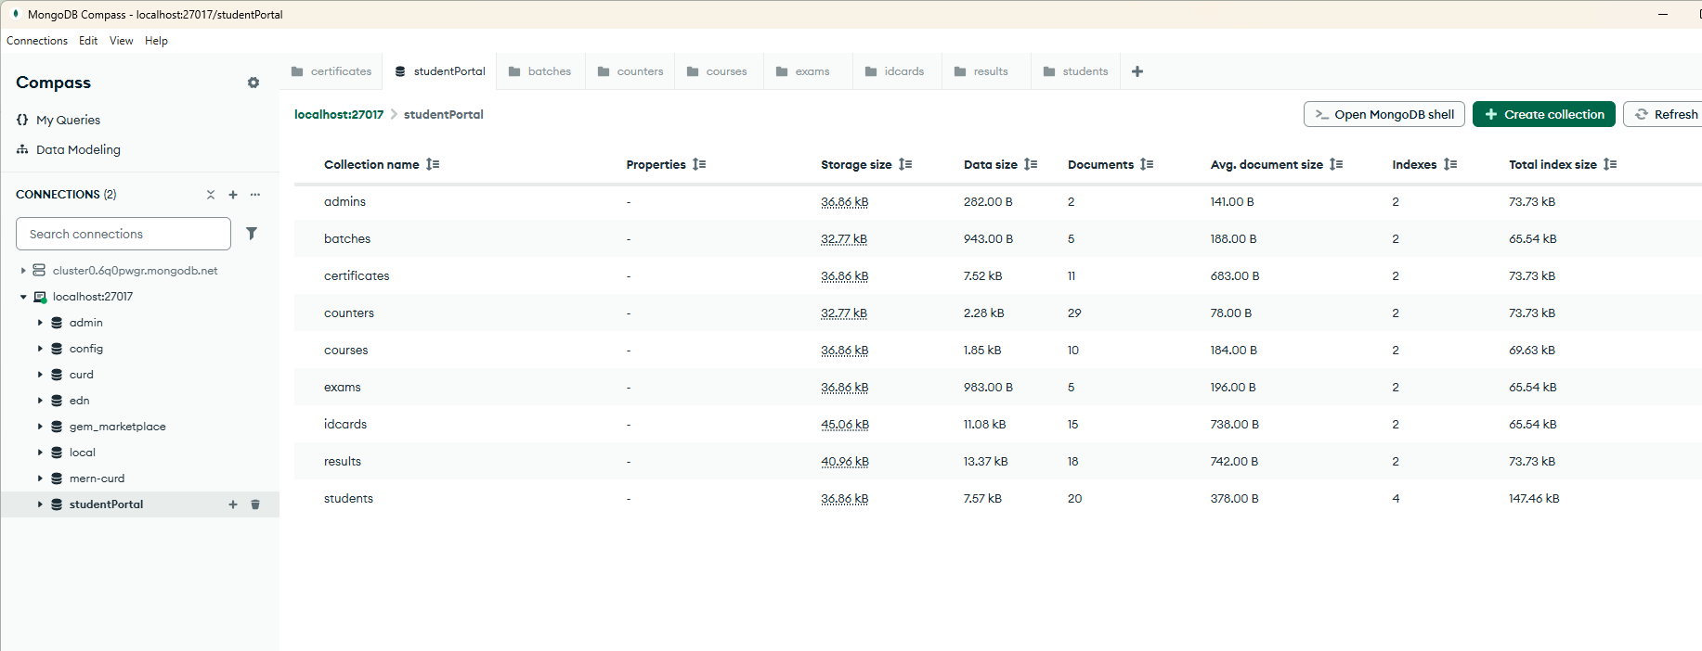
Main Processes DFD: Operational Flow
EDUCATE Portal
MongoDB Database Structure
Level 2 DFD (Document Generation Process)
Zoomed-in view of the 4-step pipeline executed during credential issuance
1.0 Fetch Student & Document Data
Pulls profile and grade data from MongoDB.
2.0 Generate Cryptographic Hash:
Computes a non-reversible SHA hash.
3.0 Interact with Smart Contract
Executes Ethereum transactions via Solidity smart contracts.
4.0 Store Receipt in Database
Records the transaction hash and block timestamp back in MongoDB.

Slide 15
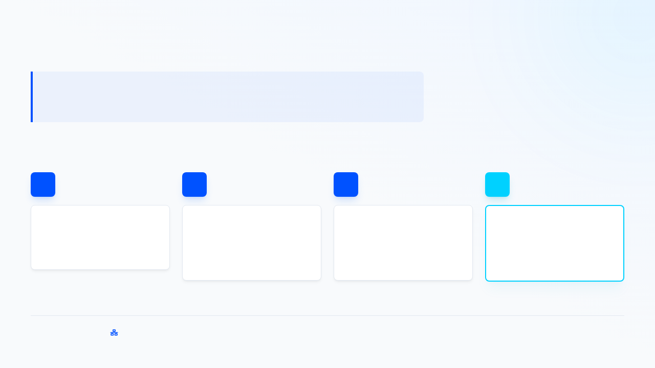
EDUCATE Portal
The Minting Process
"A secure pipeline for transforming raw academic data into
immutable blockchain assets."
01
02
03
04
Data Capture
Hashing
IPFS Upload
Minting
Extracting student performance
data from institutional databases.
Applying SHA-256 algorithms to
create a unique digital fingerprint of
the document.
Storing the actual document file
and receiving a Content Identifier
(CID).
Executing a smart contract
transaction to record the CID and
student ID on the blockchain.
IMMUTABLE LEDGER
DECENTRALIZED STORAGE
Technical Schematic: Generation Pipeline v1.0

Slide 16
EDUCATE Portal
Project Flow Process: Minting to Verification
05. Evaluation & Result Minting
06. Final Certificate Generation
Uploads marks (2 or 5 subjects); anchors semester results on-chain.
Verifies all required semesters before generating consolidated certificate.
07. Certificate Blockchain Anchoring
08. Real-Time Public Verification
Computes cryptographic hash; stores transaction on Ethereum ledger.
Employers validate Certificate, ID, or Result via QR scan.

Slide 17
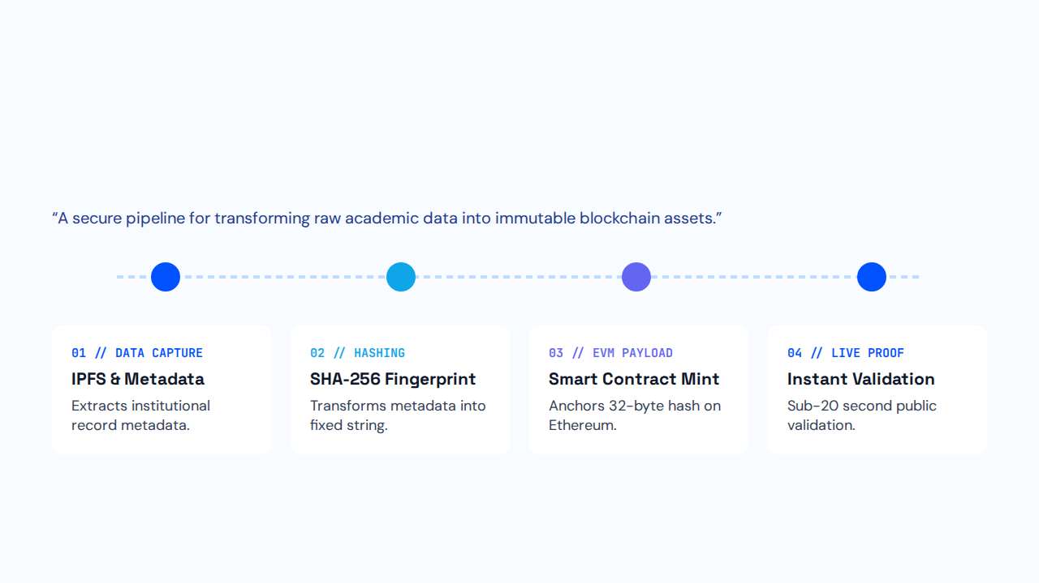
EDUCATE Portal
Cryptographic Hash Anchoring & Minting

Slide 18
EDUCATE Portal
Prerequisites & Package Dependencies
Prerequisites: Node.js (v16.x or higher recommended), npm (Node Package Manager), MongoDB Database & MetaMask.
Step 1: Backend (`/backend`)
Step 2: Frontend (`/frontend`)
Step 3: Web3 (`/ethereum`)
express: REST API framework
mongoose: MongoDB object modeling
react & vite: Core UI and bundler
hardhat: Local Ethereum node
react-router-dom: Client routing
hardhat-toolbox: Testing plugins
ethers: Ethereum interaction
qrcode.react: QR code rendering
keccak / crypto: Hash utilities
cors & multer: CORS and file uploads
jspdf & bootstrap: PDF export & UI
Solidity: Smart contract compiler

Slide 19

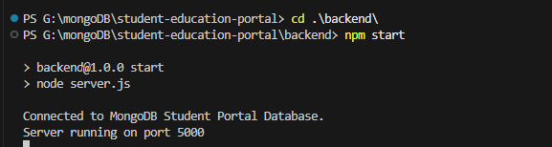
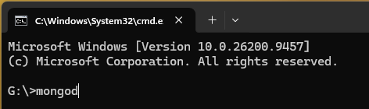

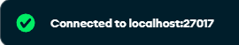


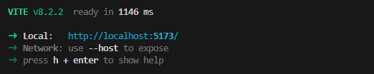
EDUCATE Portal
Instructions
Your development servers are currently running for all three modules (npx hardhat node, npm start for backend, and npm run dev for frontend).
Ethereum Directory
Go to the Ethereum directory to start the local blockchain node (Ganache/Hardhat):
cd .\ethereum\
npx hardhat node
01
Open another terminal for the Ethereum directory to deploy the smart contract to the local network:
02
cd .\ethereum\
npx hardhat run scripts/deployCertificate.js --network localhost
Backend Directory
03
Start the backend server:
cd .\backend\
npm start
Database Directory
04
Go to the Partition drive of Project – create Directories “data\db” for mongodb server
Open “CMD” from Project Directory & start mongo Server
mongod - Enter
MongoDB Server Started, Connect local database from MongoDB Compass
05
Frontend Directory
Start the frontend development server:
06
cd .\frontend\
npm run dev
07
The frontend should be accessible at http://localhost:5173/.

Slide 20
EDUCATE Portal
Platform Walkthrough & Workflows
Admin Setup Panel
On-Chain Result Minting
Web3 ID Card Flow
QR Certificate Preview
Course creation, batch setup, exam slot scheduling.
Semester marks anchored via MetaMask transactions.
Student request, fee payment, smart contract minting.
Consolidated certificate with transaction hash proof.
Multi-Course Support: Candidates can enroll across multiple courses and track individual semester scorecards and block transaction IDs.

Slide 21

01
02
03
04
05
Instructions
06
Your development servers are currently running for all three modules (npx hardhat node, npm start for backend, and npm run dev for frontend).
07
EDUCATE Portal
Project Screenshots -
Home Page – Part 1
Ethereum Directory
Go to the Ethereum directory to start the local blockchain node (Ganache/Hardhat):
cd .\ethereum\
npx hardhat node
Open another terminal for the Ethereum directory to deploy the smart contract to the local network:
cd .\ethereum\
npx hardhat run scripts/deployCertificate.js --network localhost
Backend Directory
cd .\backend\
npm start
Database Directory
Open “CMD” from Project Directory & start mongo Server
mongod - Enter
MongoDB Server Started, Connect local database from MongoDB Compass
Frontend Directory
cd .\frontend\
npm run dev
The frontend should be accessible at http://localhost:5173/.

Slide 22
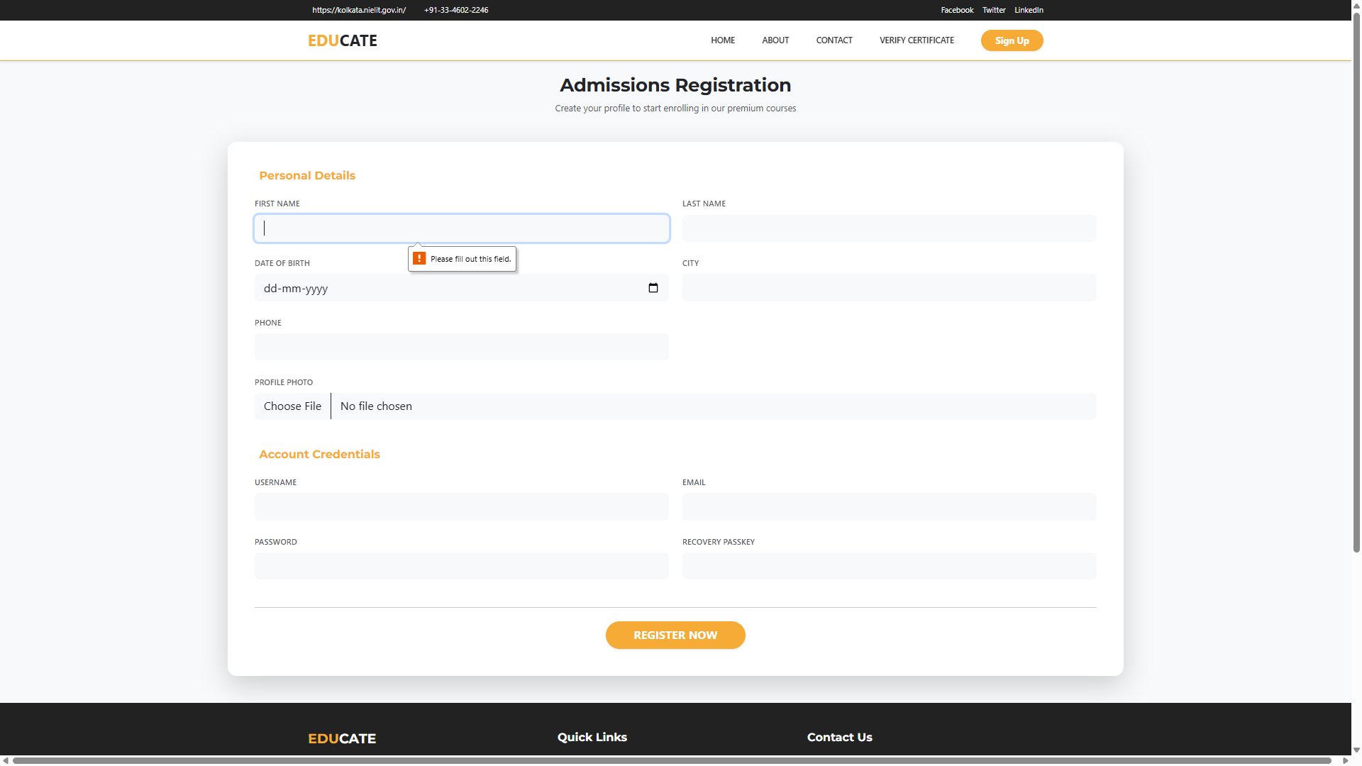
EDUCATE Portal
Project Screenshots -
Candidate Signup Page

Slide 23
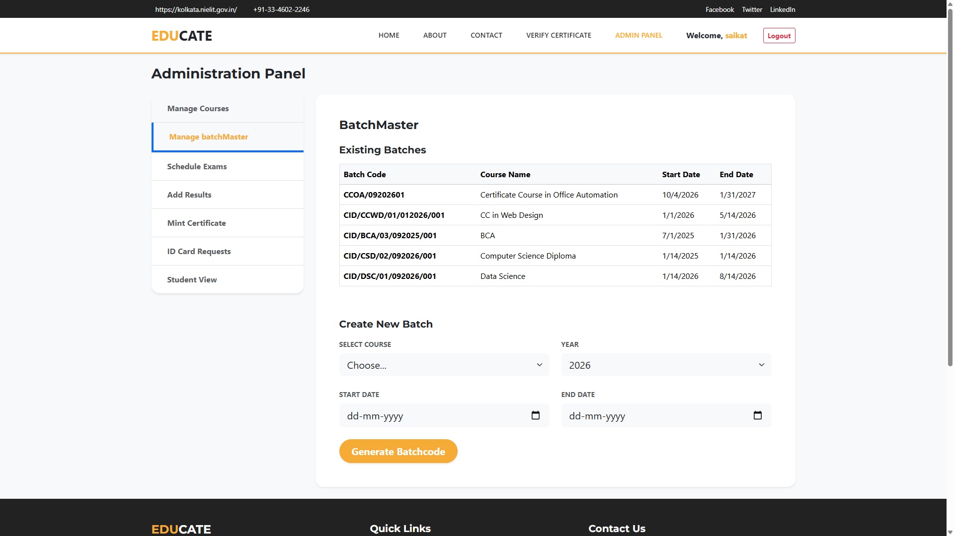
EDUCATE Portal
Project Screenshots -
Admin Dashboard

Slide 24
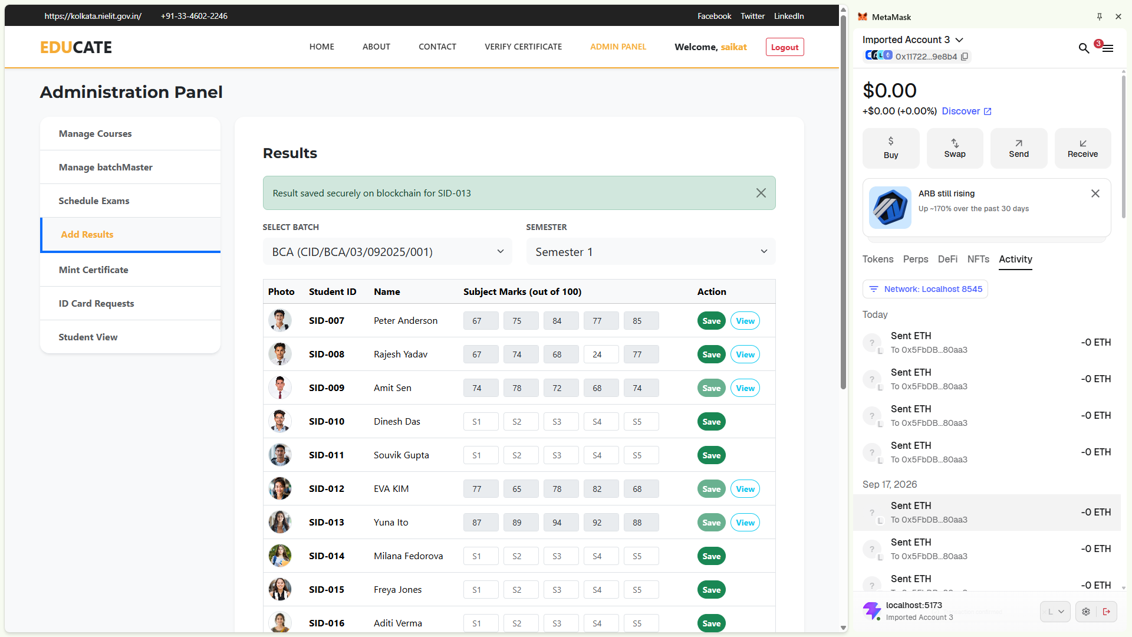
EDUCATE Portal
Project Screenshots -
Admin Services – Generate Smart Contract for Marks Details

Slide 25
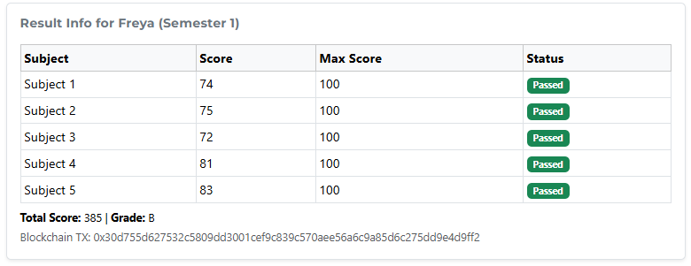
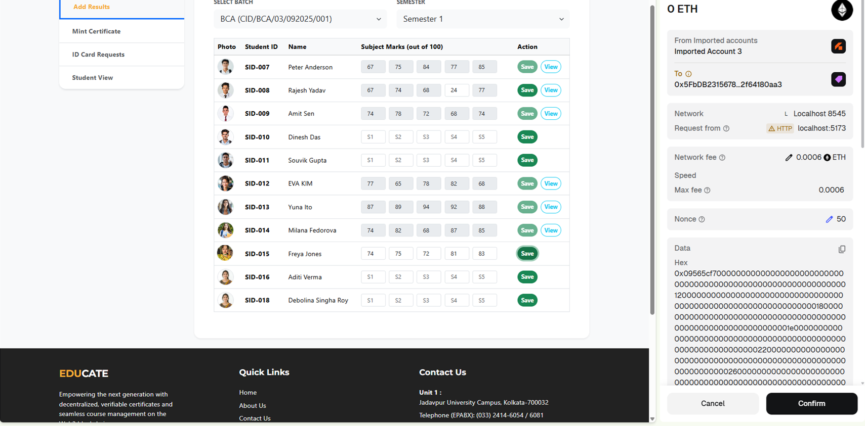
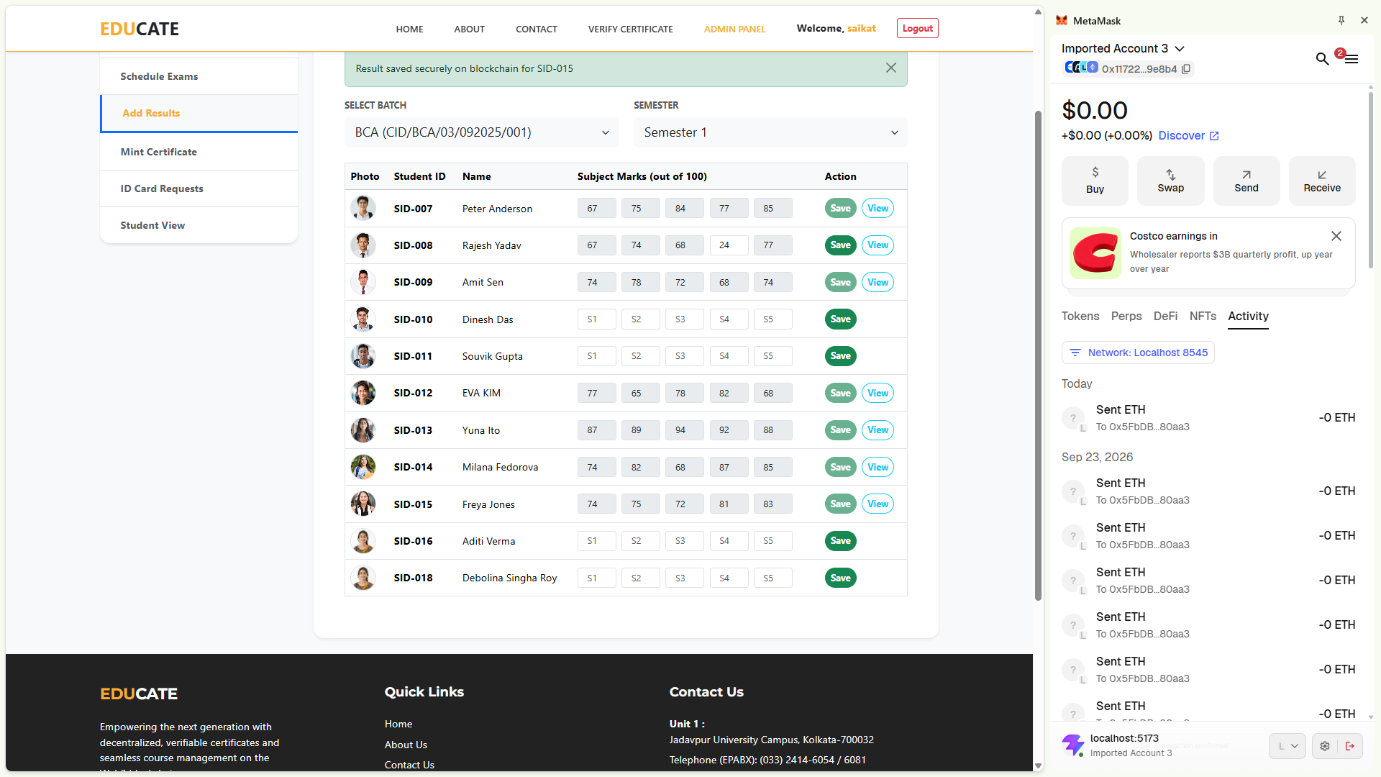

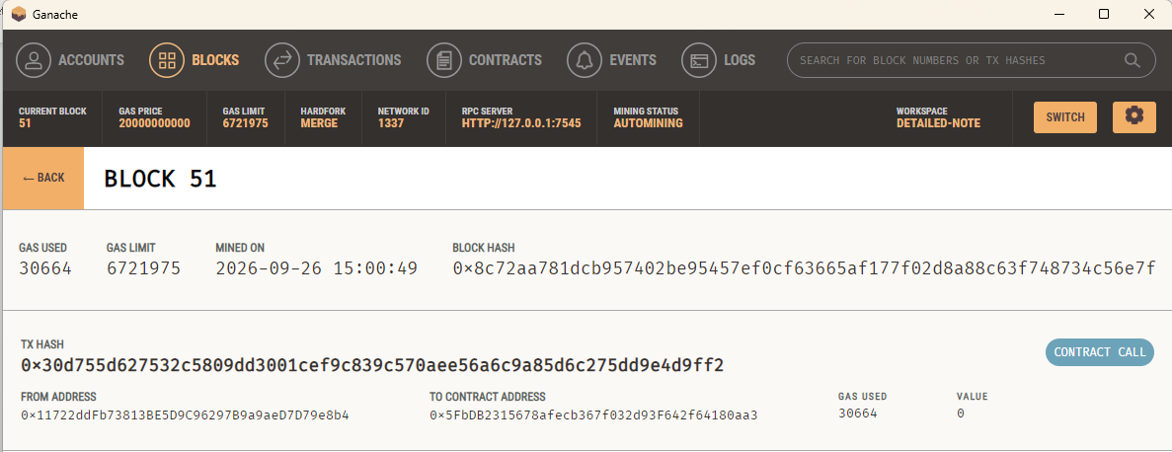
EDUCATE Portal
Project Screenshots -
Admin Services – Add Marks to Individual Candidate

Slide 26
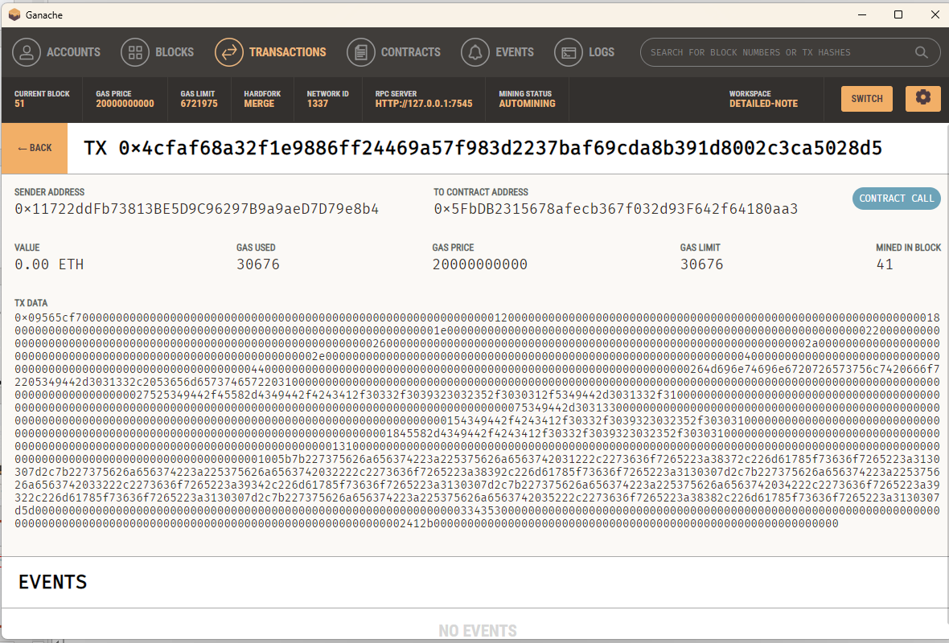
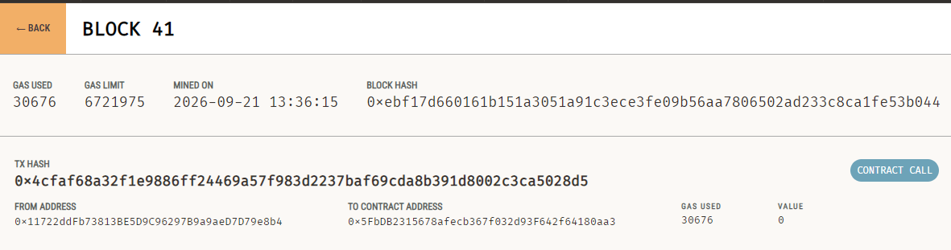
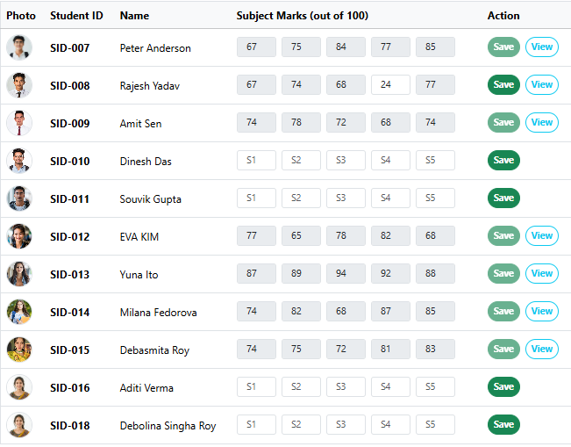
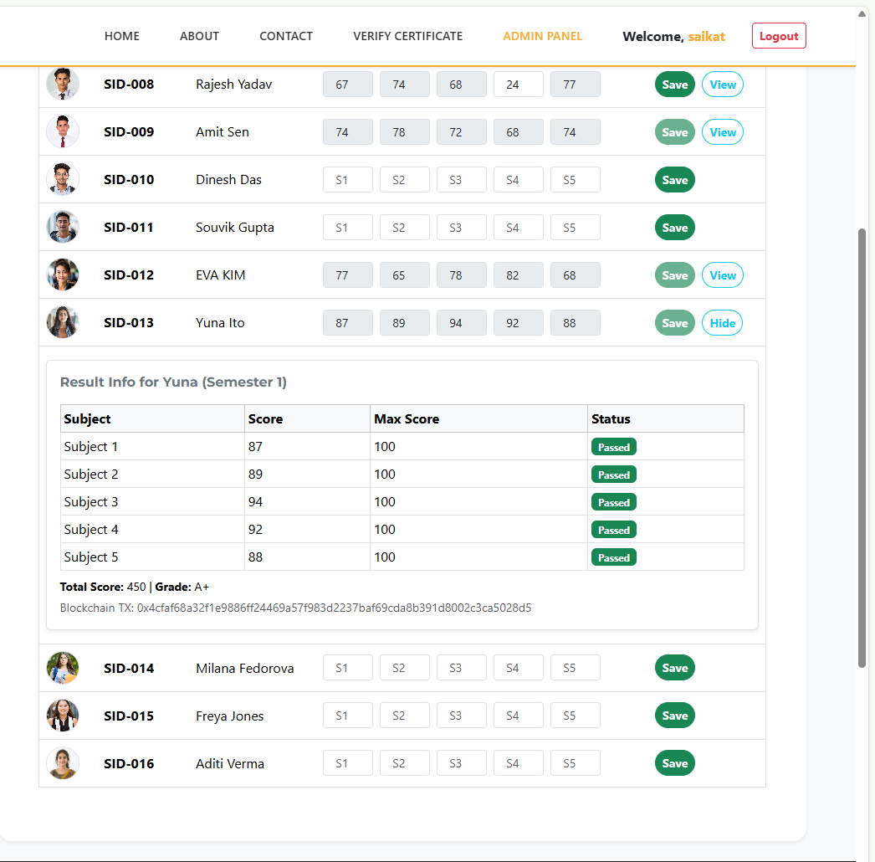

EDUCATE Portal
Project Screenshots -
Admin Services – Save the Marks into Blockchain Smart Contract using Metamask & Local Ganache

Slide 27
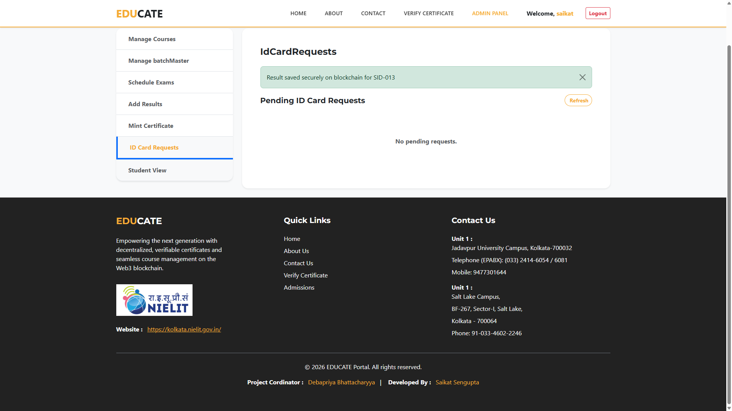
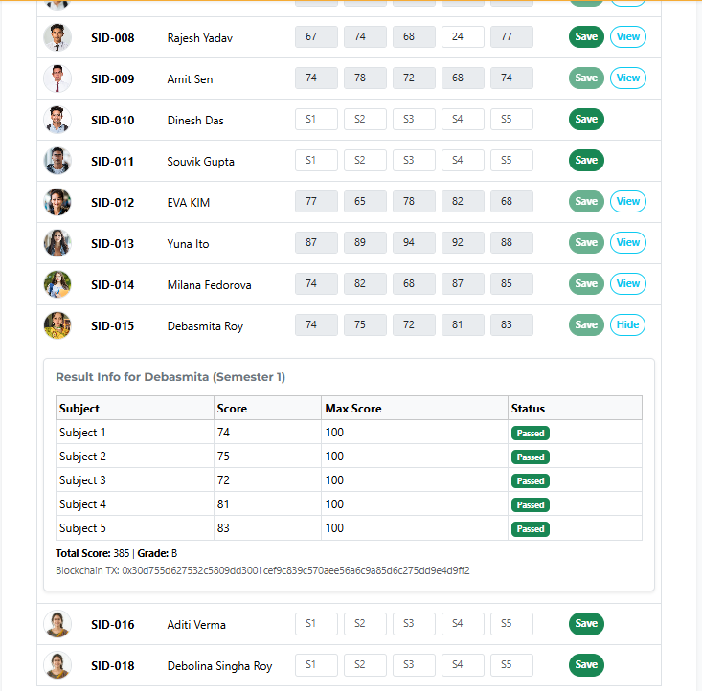
EDUCATE Portal
Project Screenshots -
Admin Services – View Candidate Results with Transaction Block ID

Slide 28
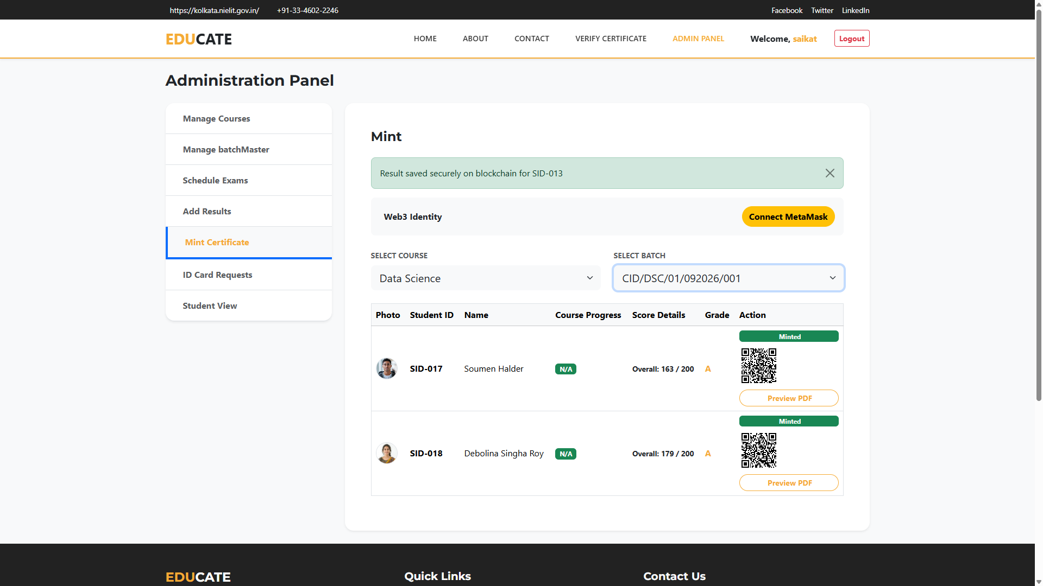
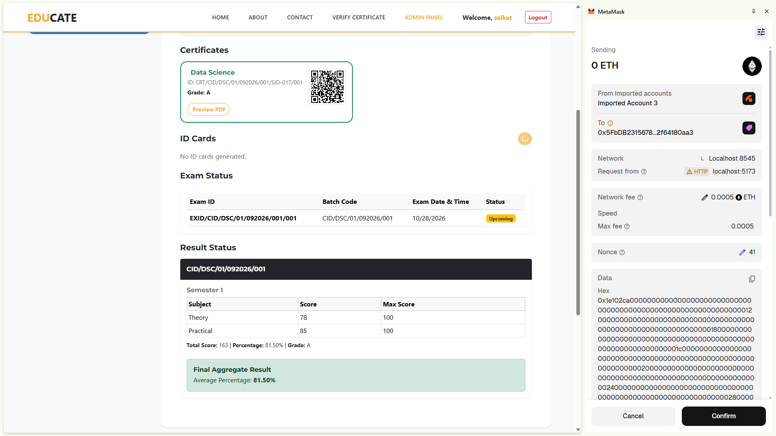
EDUCATE Portal
Project Screenshots -
Admin Services – Candidate ID Card Information send into smart contract

Slide 29
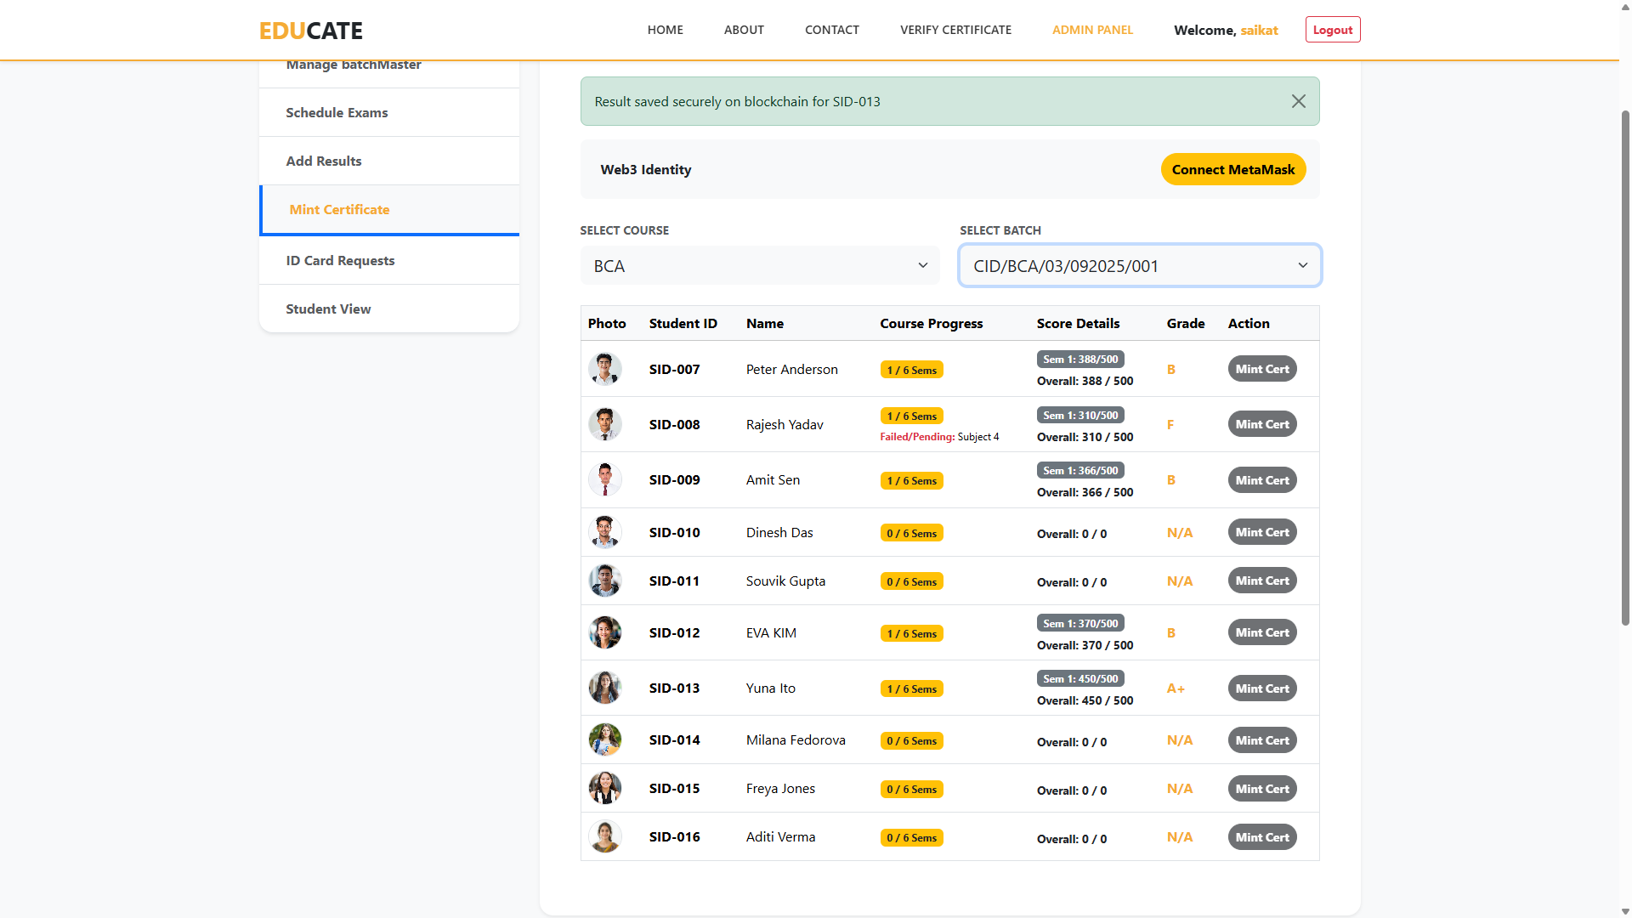
EDUCATE Portal
Project Screenshots -
Admin Services – List of candidate certificate status view (certificate)

Slide 30
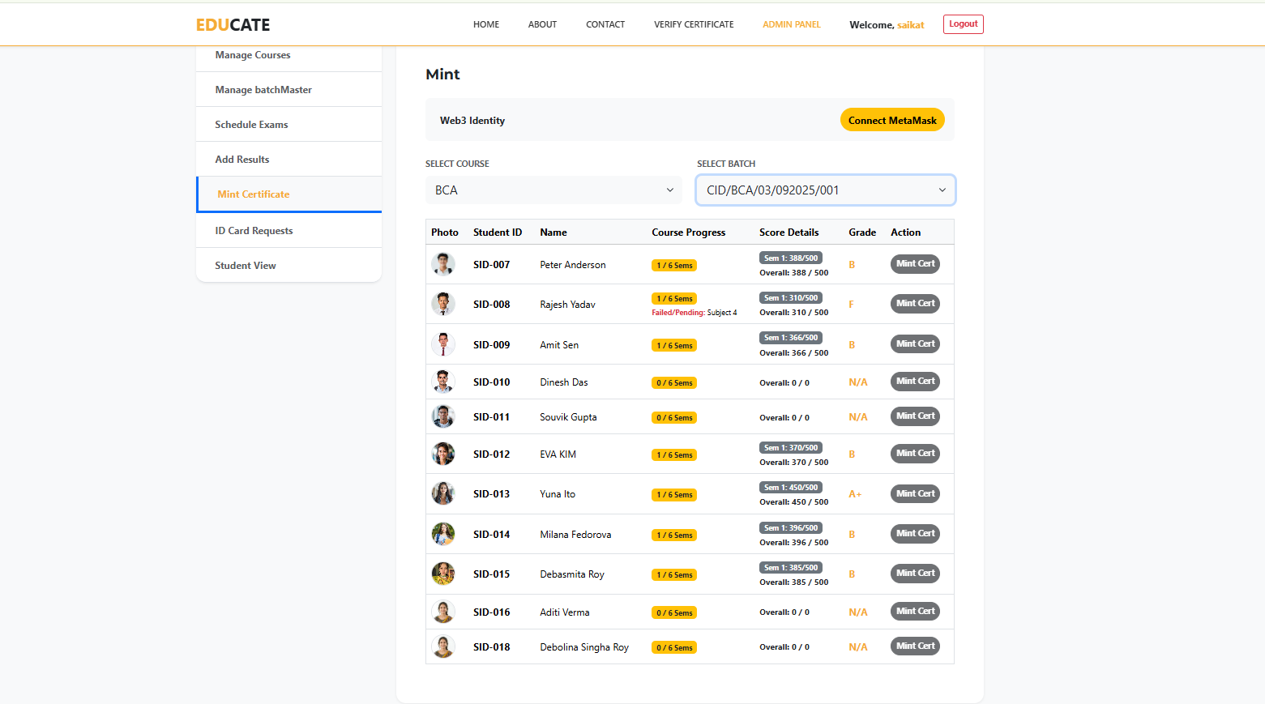
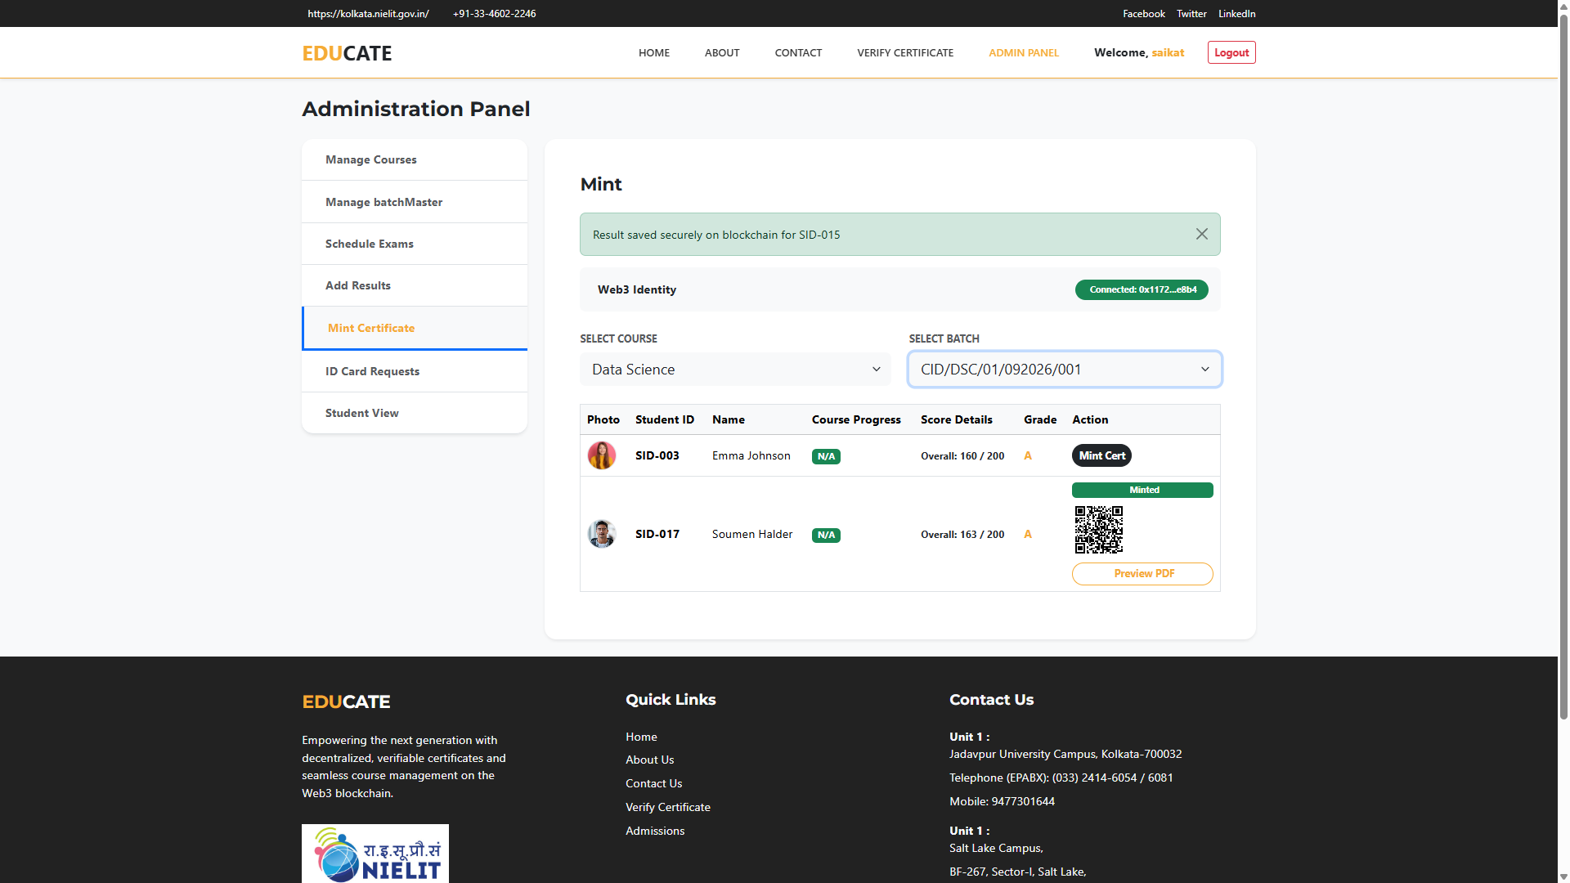

EDUCATE Portal
Project Screenshots -
Admin Services – Certificate Generation Panel – for Degree

Slide 31
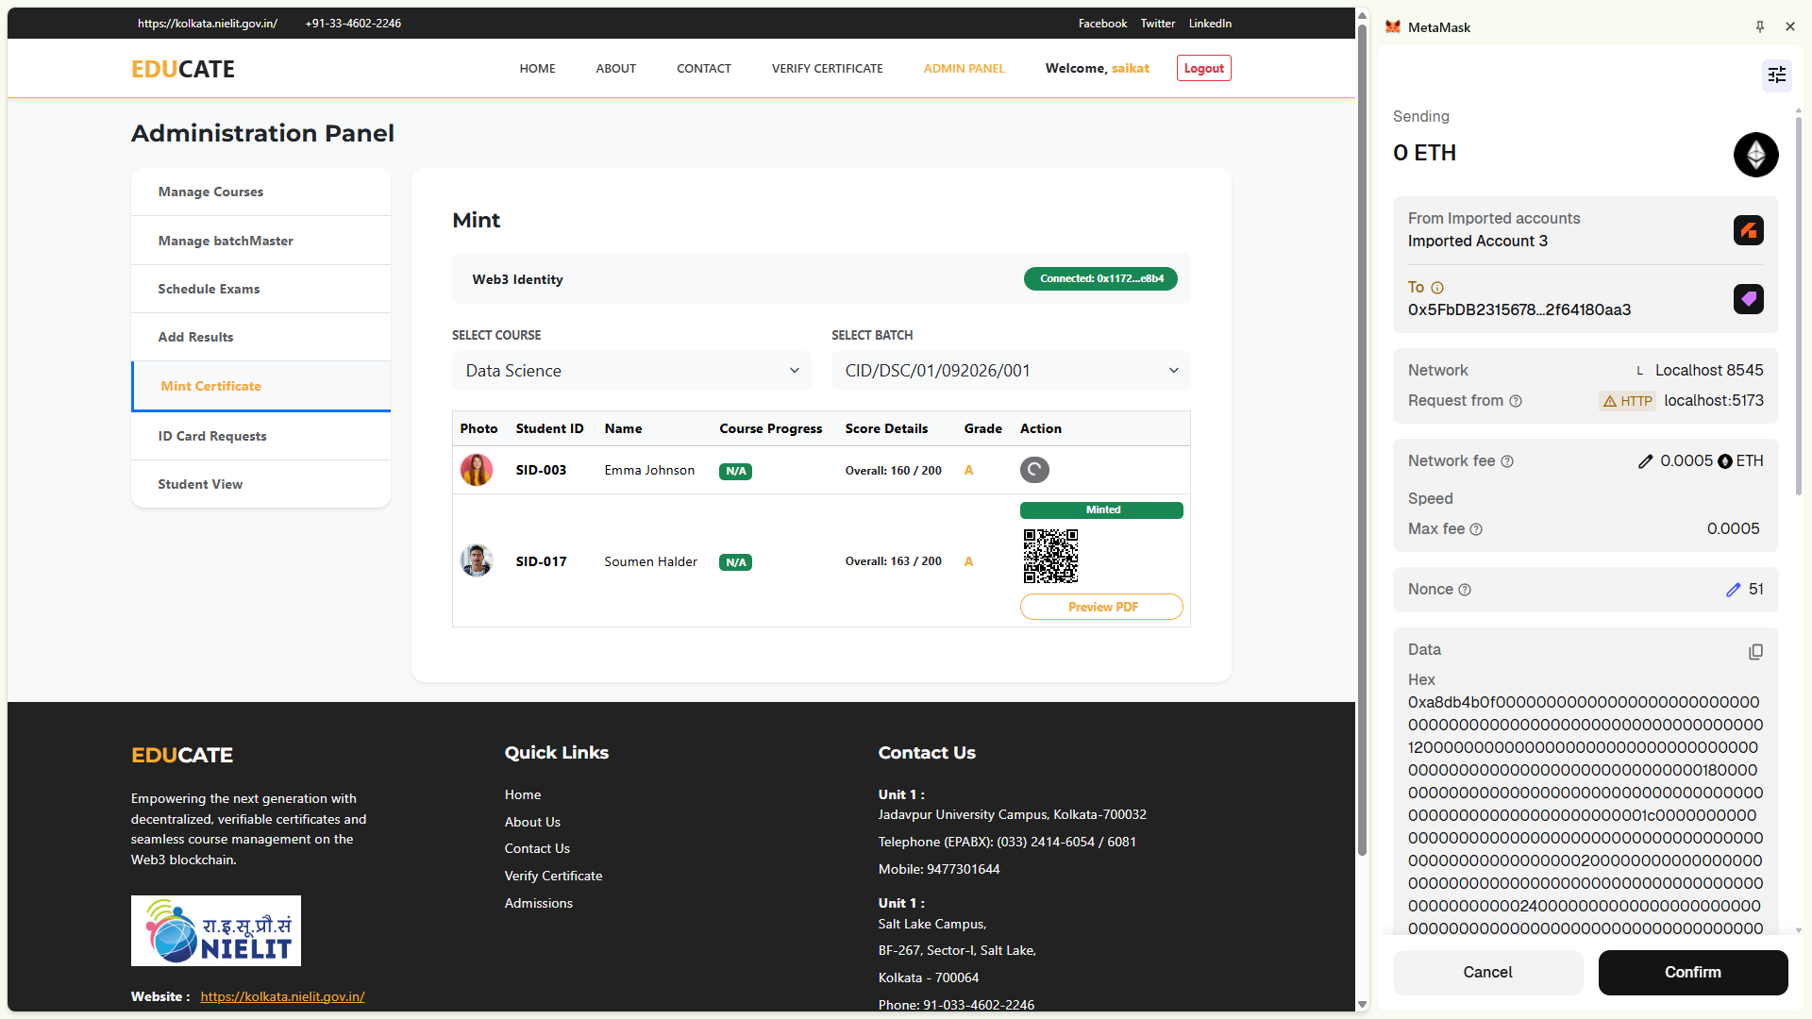

EDUCATE Portal
Project Screenshots -
Admin Certificate Generation – Process flow One -
connect metamask by clicking on Mint Cert button

Slide 32
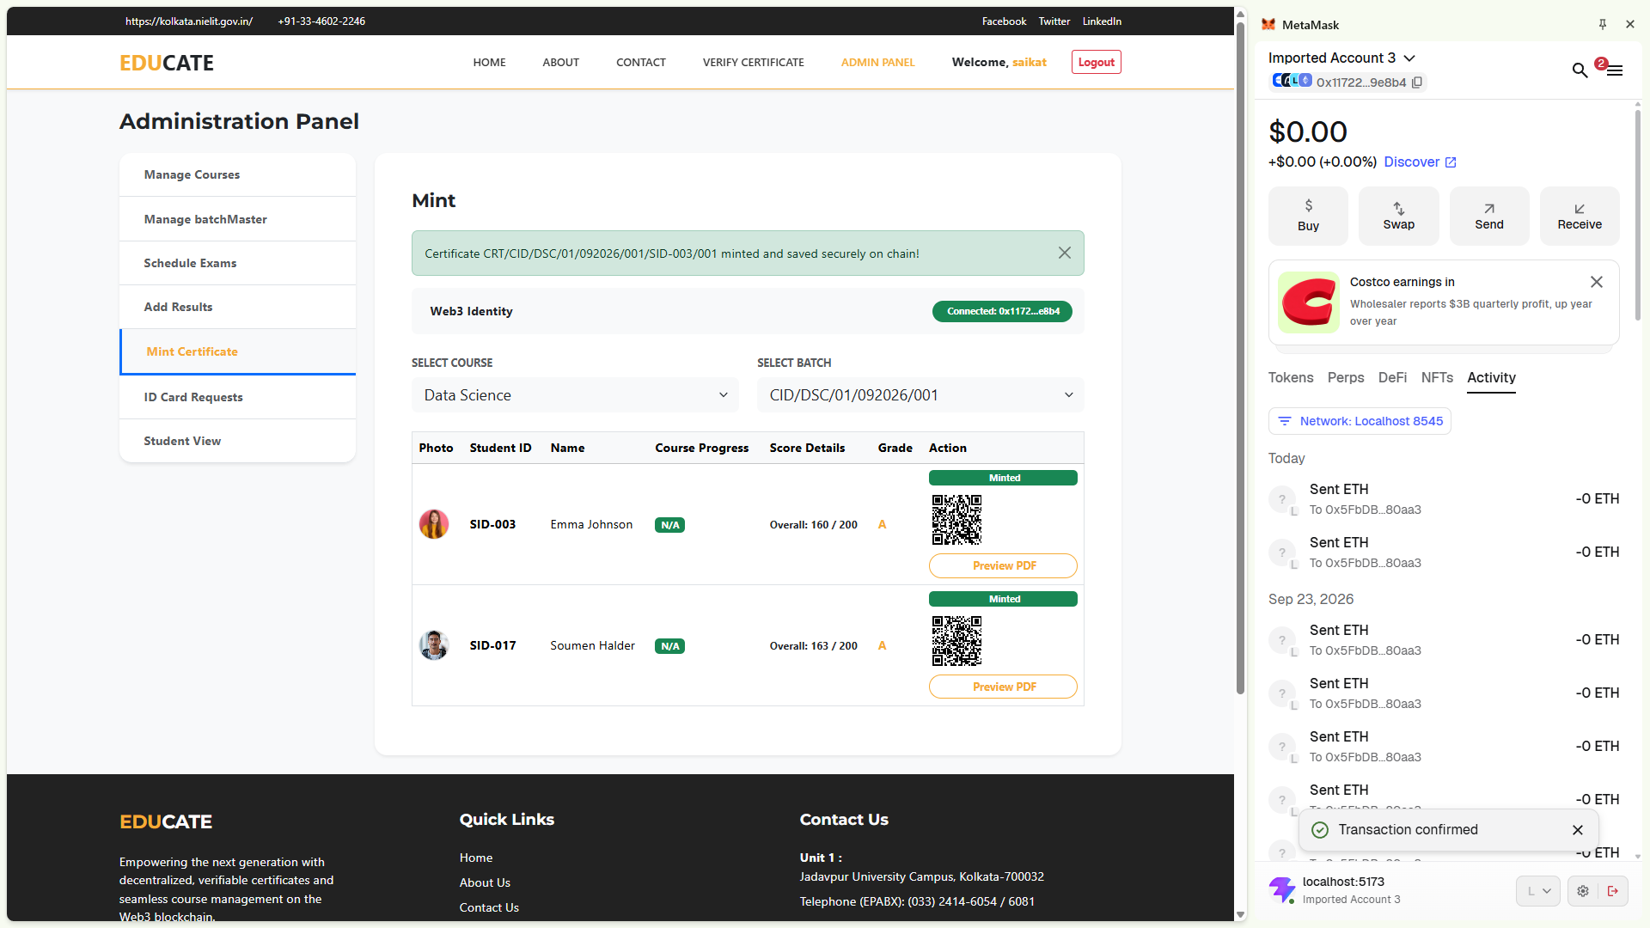
EDUCATE Portal
Project Screenshots -
Admin Certificate Generation – Process flow Two -
Transaction process using Either (localhost – ganache)

Slide 33
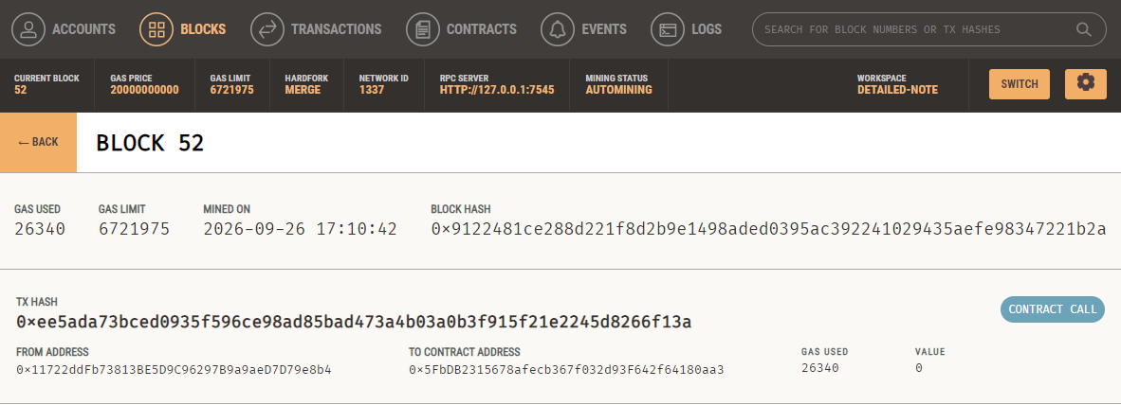
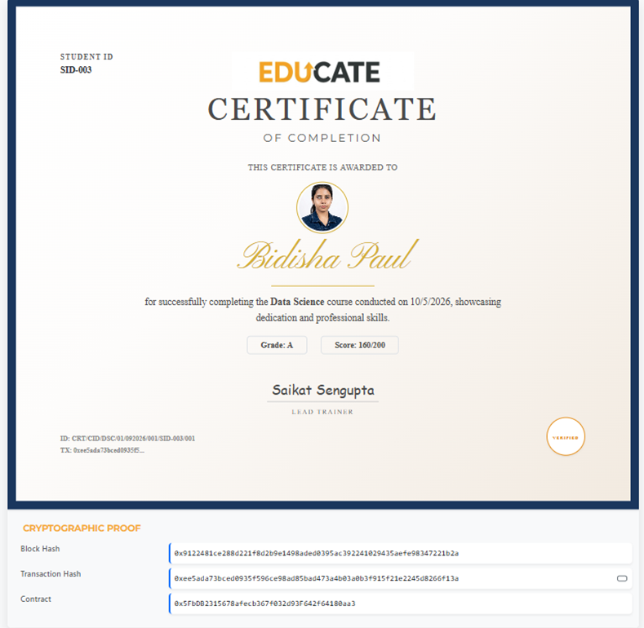
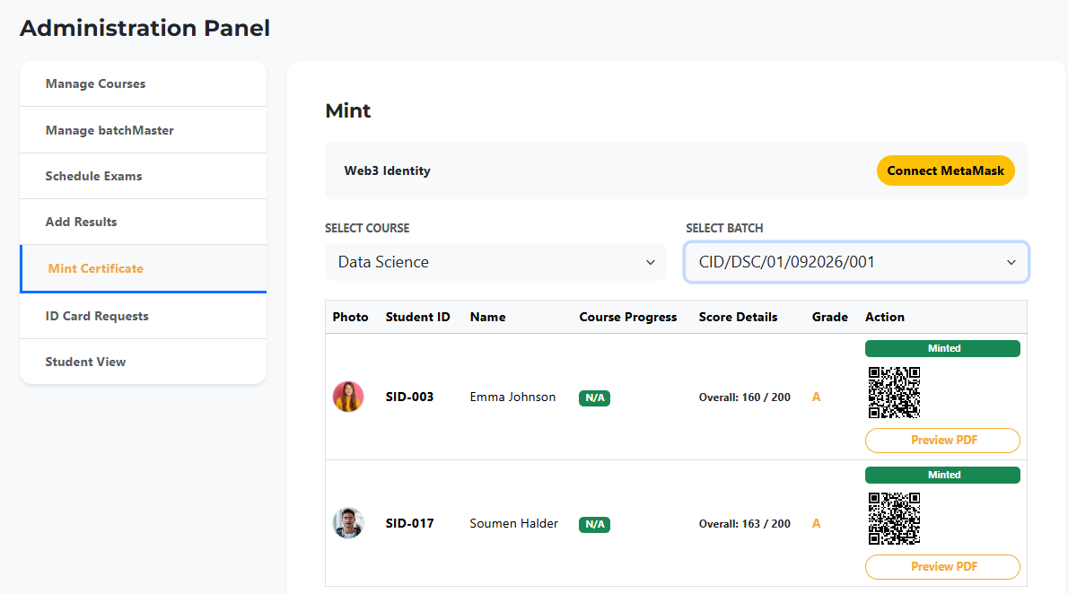
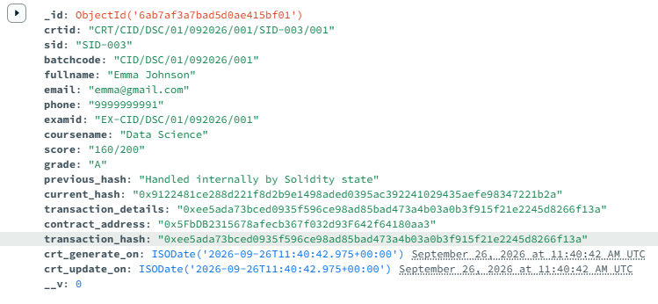
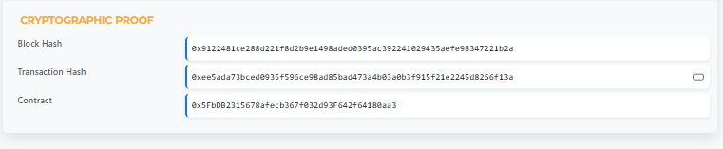
EDUCATE Portal
Project Screenshots -
Admin Certificate Generation – Process flow Four -
Generated new certificate

Slide 34
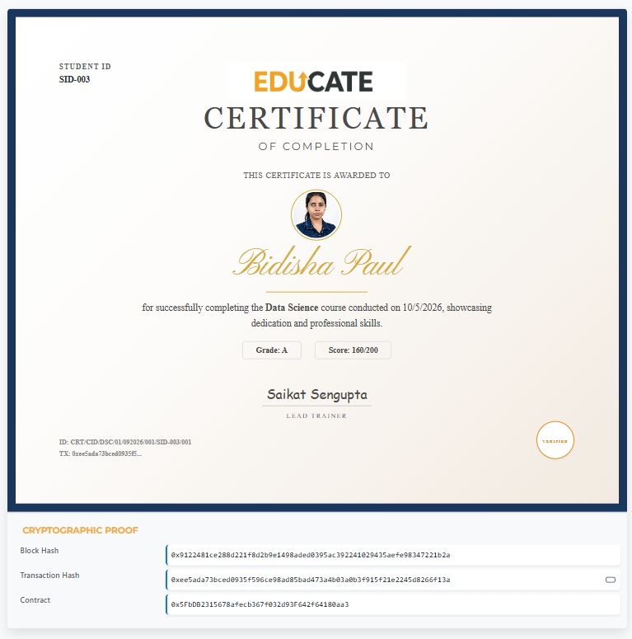
EDUCATE Portal
Project Screenshots -
Admin Certificate Generation – Process flow Four -
Final certificate preview with Smart Contract & Database Infprmation

Slide 35
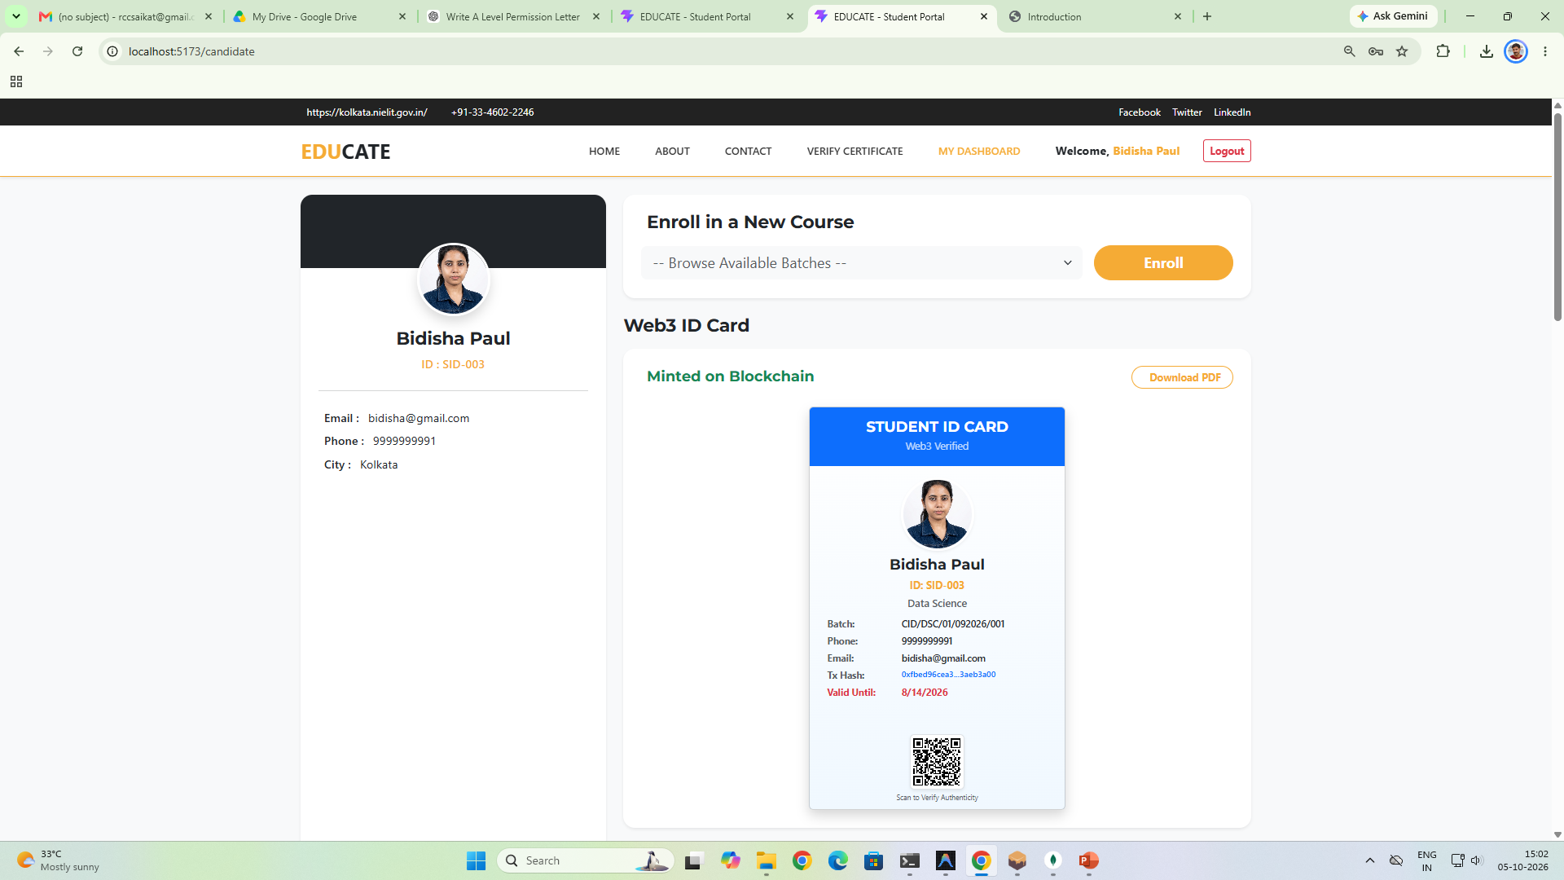
EDUCATE Portal
Project Screenshots -
Candidate Dashboard Services

Slide 36
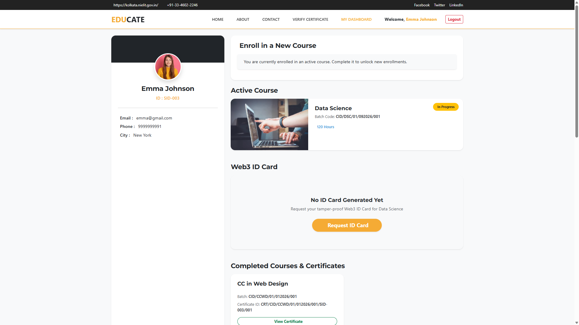
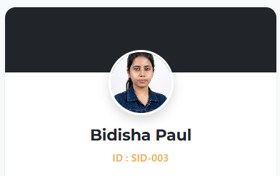
EDUCATE Portal
Project Screenshots -
Candidate Dashboard Services - Enroll new Courses

Slide 37
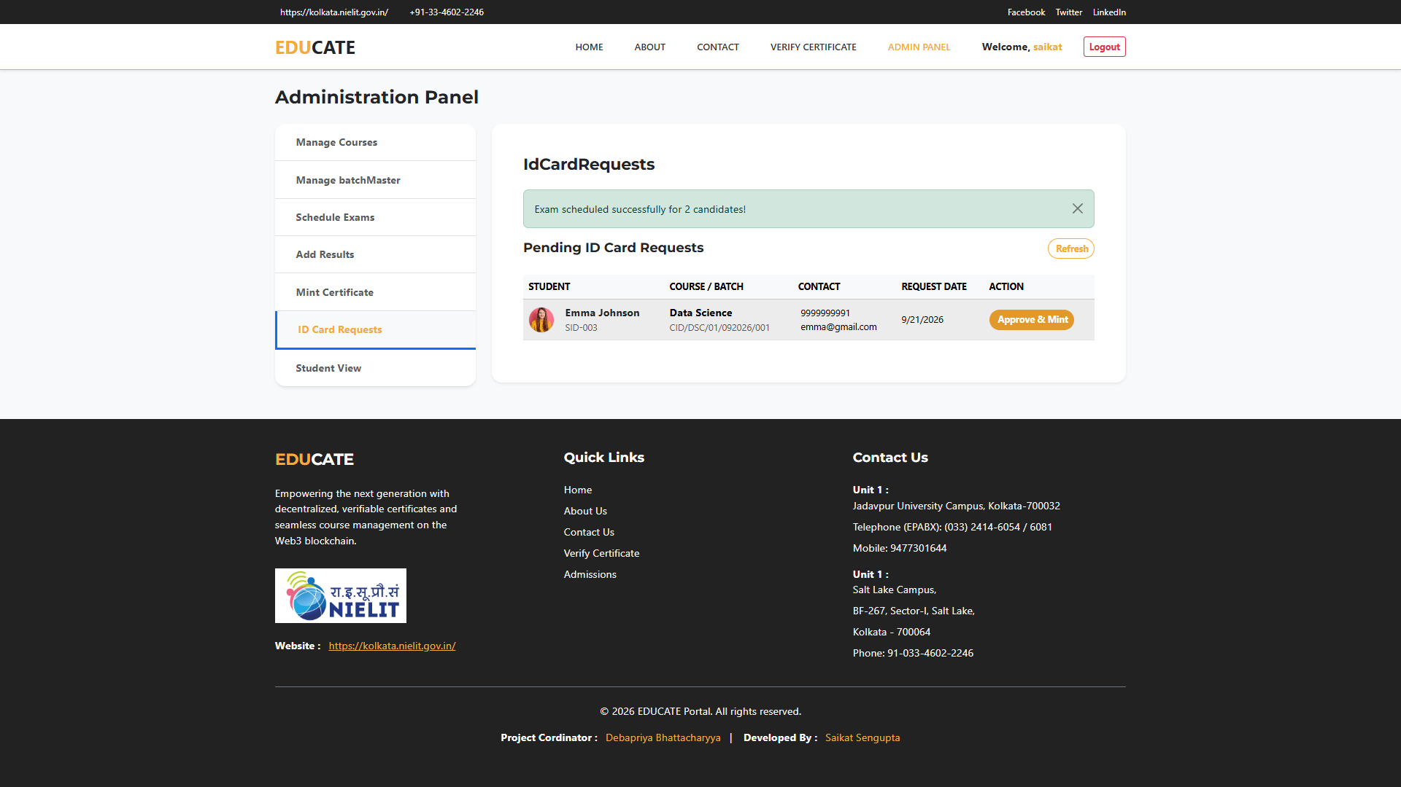

EDUCATE Portal
Project Screenshots -
Admin Dashboard Services - Request for ID Approval

Slide 38
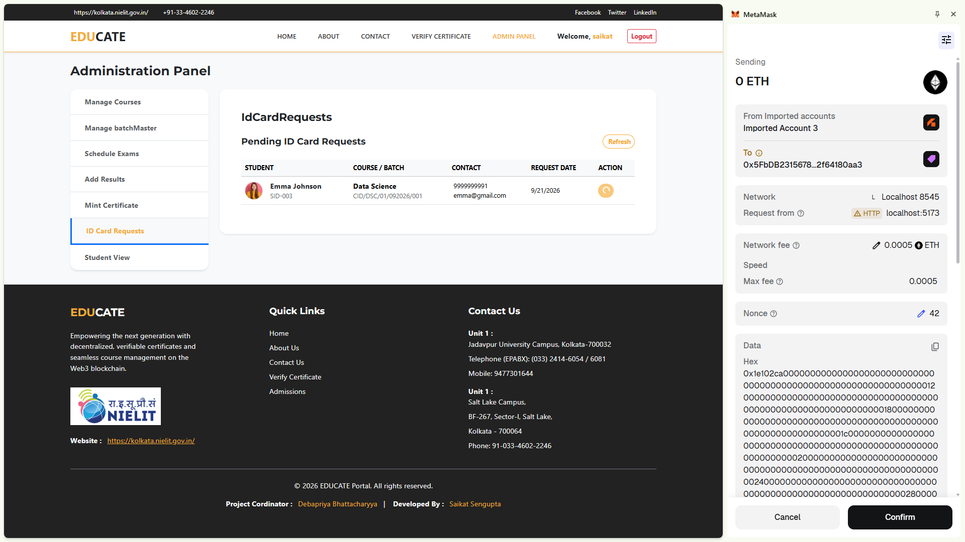

EDUCATE Portal
Project Screenshots -
Candidate Dashboard Services - Payment for ID generation by Admin Site

Slide 39
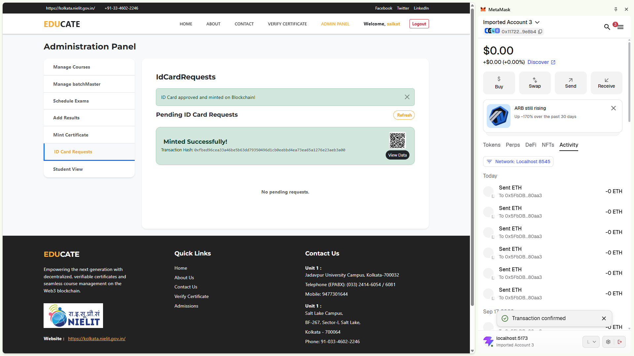
EDUCATE Portal
Project Screenshots -
Candidate Dashboard Services - ID generation by Admin Site

Slide 40
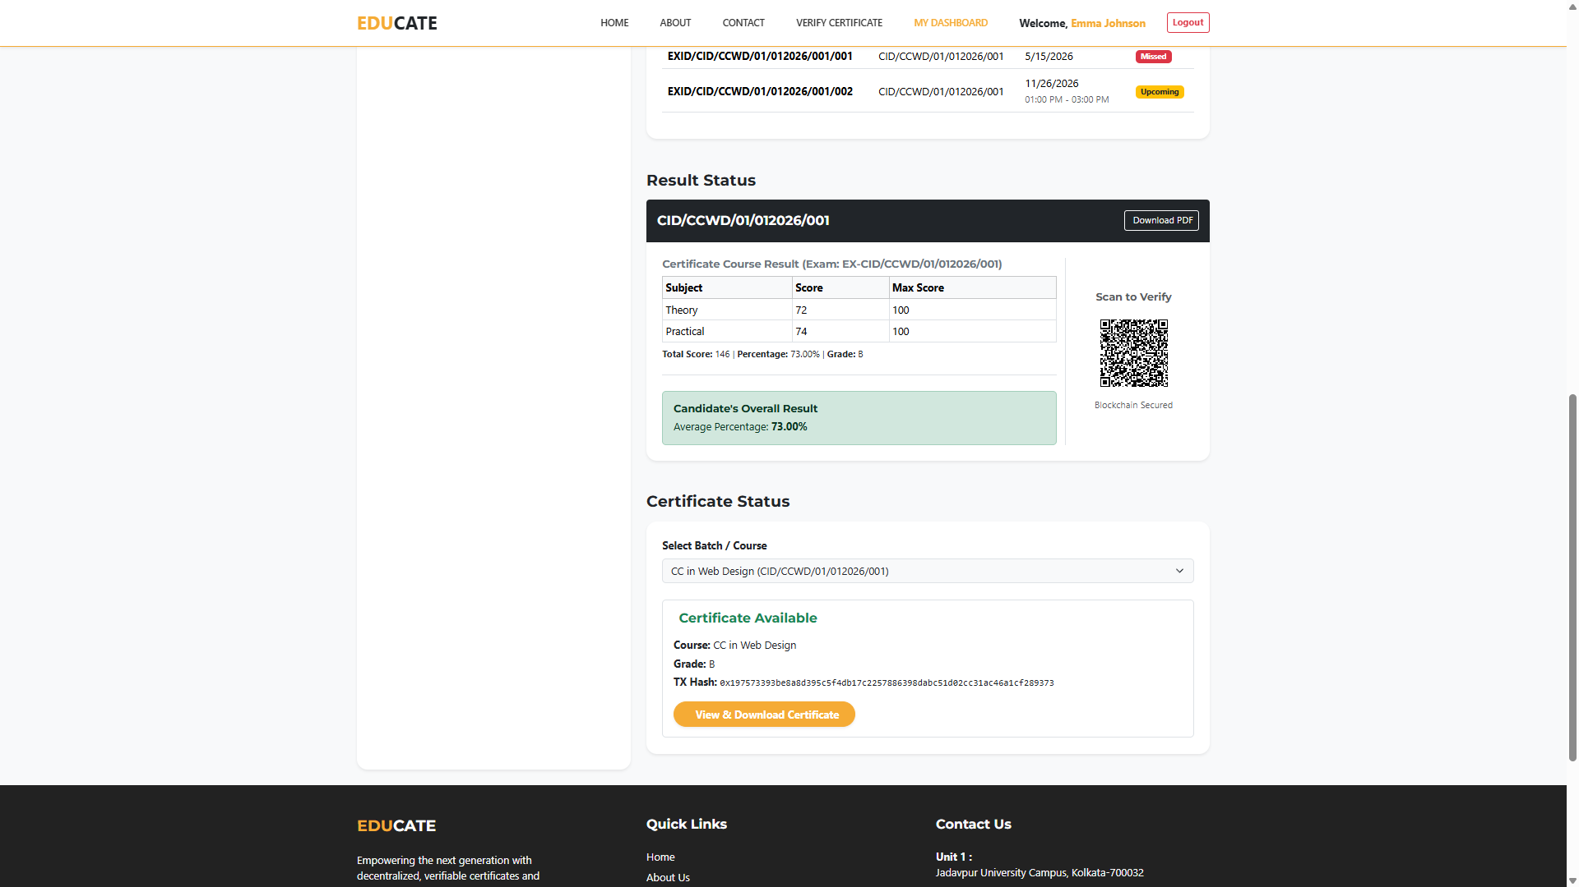
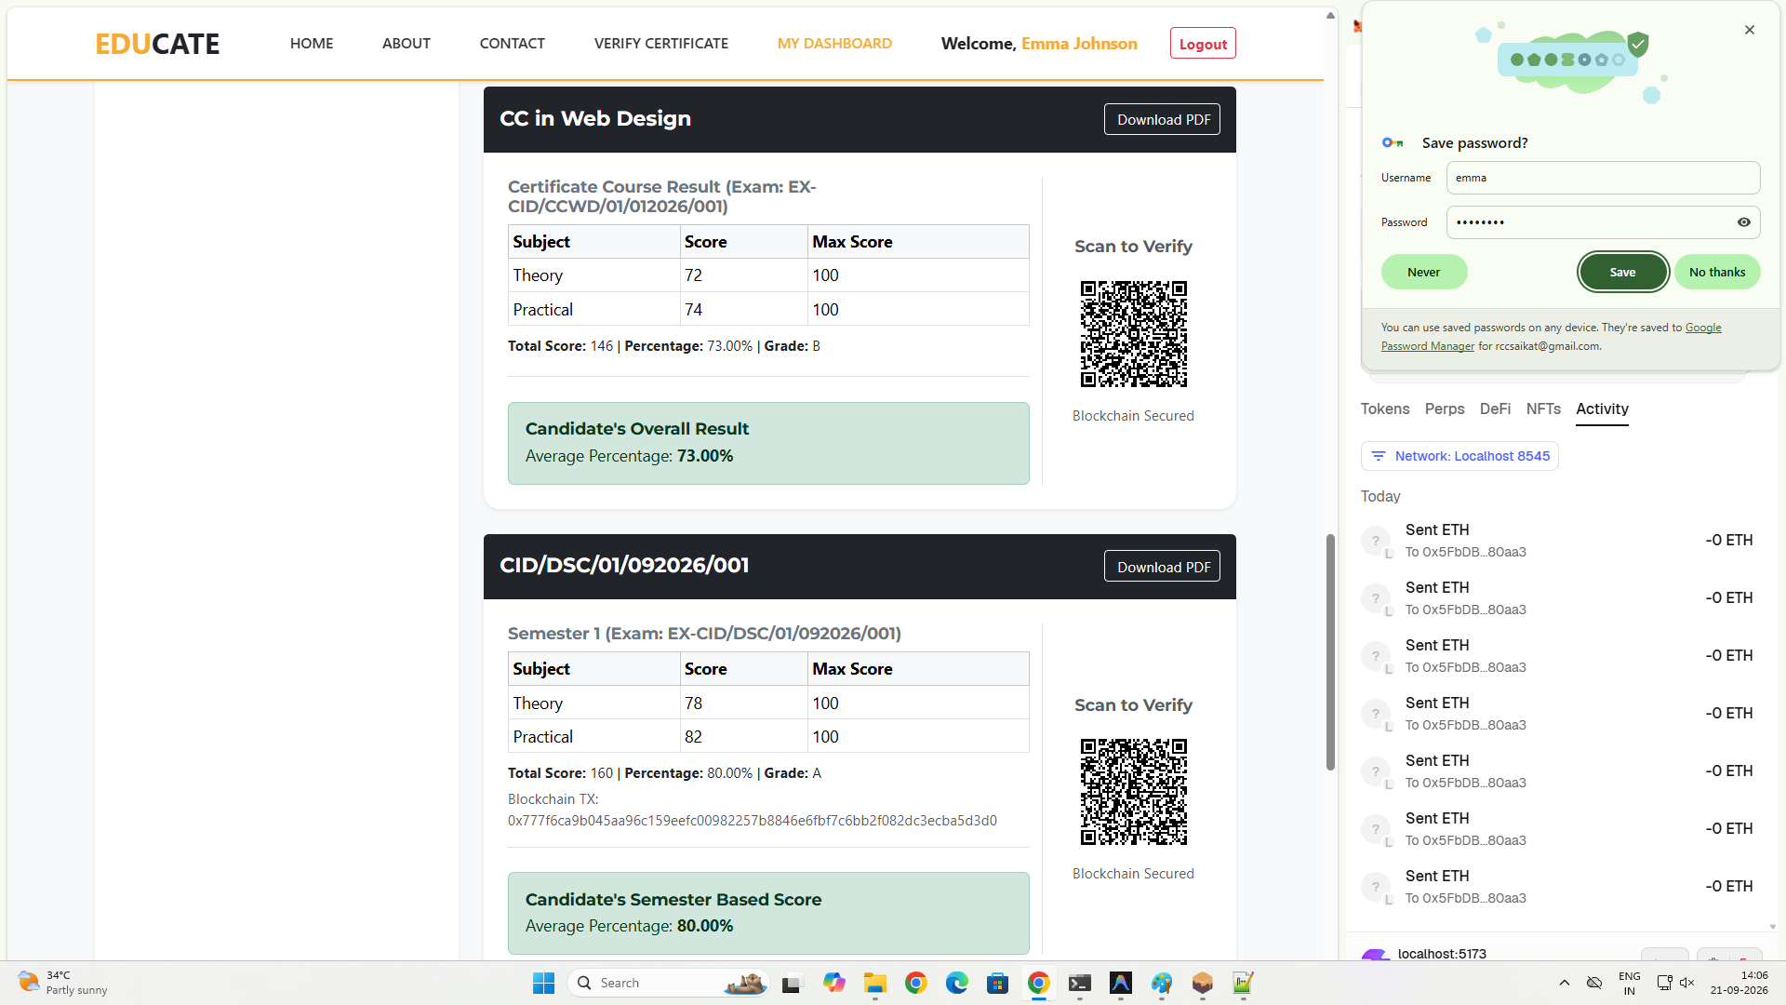
EDUCATE Portal
Project Screenshots -
Candidate Dashboard Services - Result view after published for enrolled courses

Slide 41

EDUCATE Portal
Project Screenshots -
Candidate Dashboard Services - Certificate status view

Slide 42



EDUCATE Portal
Project Screenshots -
Candidate Dashboard Services - Certificate Final Certificate view

Slide 43




EDUCATE Portal
Project Screenshots -
Admin Dashboard Services - Student Search view

Slide 44

EDUCATE Portal
CONCLUSION
THE FUTURE OF
https://github.com/saikatssg/student-education-portal/tree/main
Repository Link :
"Restoring trust in academic credentials through decentralized
innovation."

